Slide 1
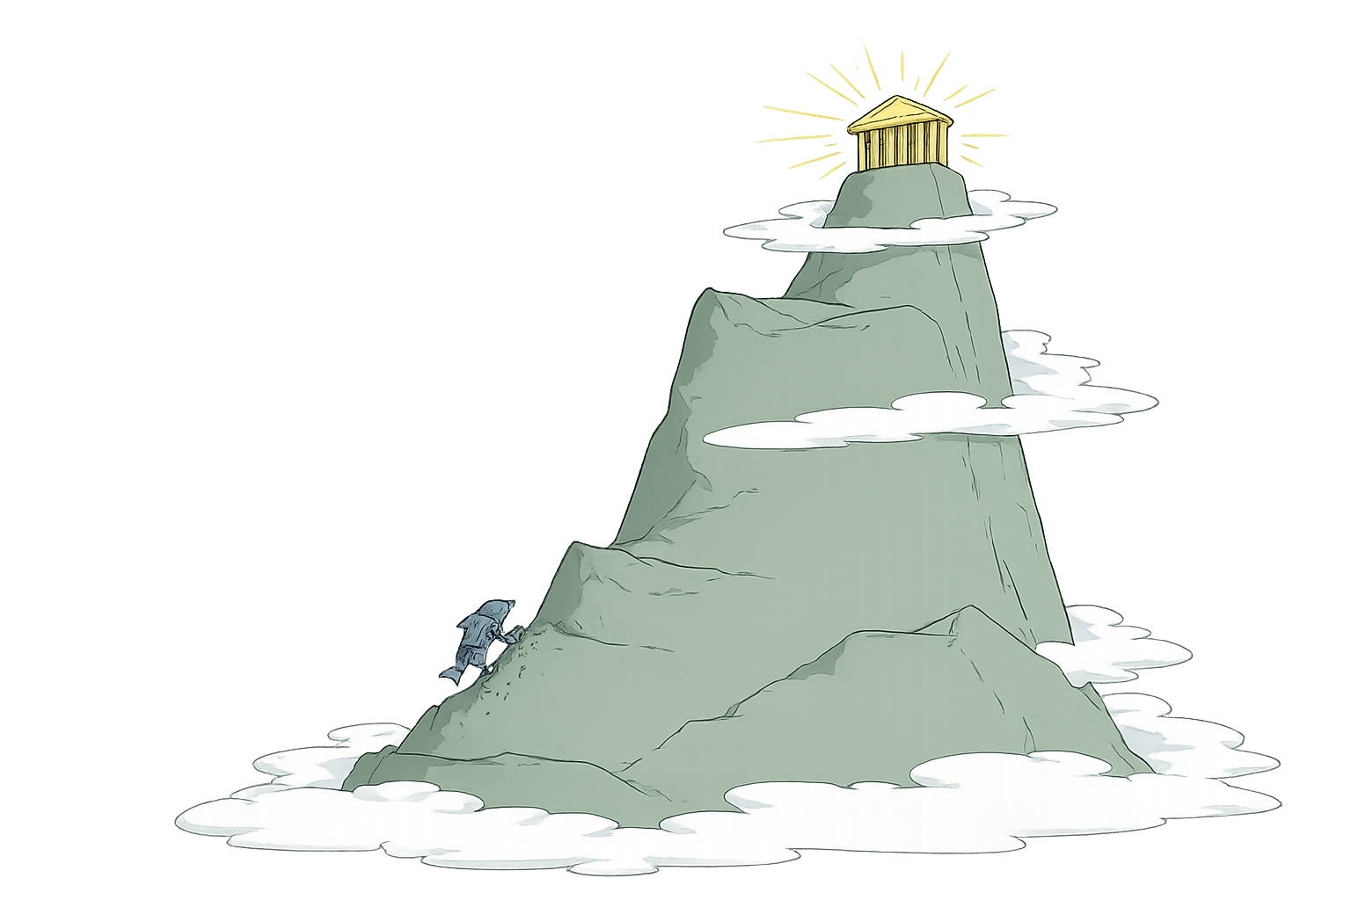
CALIFORNIA STATE UNIVERSITY CHANNEL ISLANDS
COMP 469 · Introduction to Artificial Intelligence
Search in Complex
Environments
Local Search and Optimization Problems
Russell & Norvig, Artificial Intelligence: A Modern Approach (4th ed.) — Sections 4.1 and 4.2
Two-hour lecture · Lecture 04
Notes:
Two-hour session. Frame the whole lecture in one sentence before advancing: for the last three weeks every algorithm we studied returned a PATH; today every algorithm returns a STATE. That single change buys us problems that were previously out of reach, and costs us every guarantee we had. Coverage: 4.1 (local search and optimization: hill climbing, simulated annealing, local beam search, evolutionary algorithms) and 4.2 (continuous spaces). Sections 4.3-4.5 are next lecture.

Slide 2
COURSE ROADMAP
Chapter 3 solved an easy world. Chapter 4 breaks it.
Chapter 3 assumed environments that were fully observable, deterministic, static, and known, and it asked for a sequence of actions. Chapter 4 relaxes those assumptions one at a time.
4.1 – 4.2
4.3
4.4
4.5
The path stops mattering
Determinism drops
Observability drops
The map itself is unknown
We want a good final state, in discrete and then continuous spaces.
Actions can have several outcomes, so the solution becomes a conditional plan.
The agent tracks a belief state: the set of states it might be in.
Online search interleaves acting and learning about the space.
Today
A useful sanity check for the rest of the term: whenever you meet a new search algorithm, ask which of these four assumptions it still relies on. Almost every difficulty in the chapter traces back to one of them.
COMP 469 · Introduction to Artificial Intelligence · CSU Channel Islands
2
Notes:
Two minutes. Point out that today's relaxation is the least intuitive of the four to state but the easiest to motivate: nobody cares HOW you arrived at a valid 8-queens configuration. If students ask why 4.1 and 4.2 are grouped: they are the same idea (find a good state, ignore the path) in discrete and continuous state spaces respectively. 4.2 is where the connection to machine learning appears.

Slide 3
Learning objectives
By the end of this session you should be able to:
1
Decide
2
Formulate
Recognise when a problem is a local search problem — when the goal state is the solution and the path is irrelevant.
Write a complete-state formulation: states, successor function, and objective or heuristic value function.
3
Trace
4
Diagnose
Execute hill climbing, simulated annealing, local beam search, and a genetic algorithm by hand on 8-queens.
Identify local maxima, ridges, and plateaus in a state-space landscape and name the countermeasure for each.
5
Analyse
6
Extend
Compute expected restarts and expected total steps for random-restart hill climbing given a success probability.
Apply discretization, empirical gradients, gradient descent, and Newton–Raphson to a continuous state space.
COMP 469 · Introduction to Artificial Intelligence · CSU Channel Islands
3
Notes:
Read objectives 3 and 5 aloud — those are the ones that appear on the midterm in almost exactly that form. Objective 5 in particular: students routinely memorise 'expected restarts = 1/p' and then cannot handle the follow-up about expected total steps including failed runs.

Slide 4
How the two hours are spent
0:00 – 0:10
Framing: from paths to states
4.1 intro
0:10 – 0:38
Hill climbing and its three failure modes
4.1.1
0:38 – 0:55
Simulated annealing
4.1.2
0:55 – 1:05
Break
1:05 – 1:17
Local beam search
4.1.3
1:17 – 1:37
Evolutionary algorithms
4.1.4
1:37 – 1:57
Local search in continuous spaces
4.2
1:57 – 2:00
Wrap-up and preview of 4.3–4.4
COMP 469 · Introduction to Artificial Intelligence · CSU Channel Islands
4
Notes:
Put this on screen during the first minute and leave the break time visible. Students settle faster when they know when the break lands. If you are running long, the compressible material is: the evolutionary algorithms design-dimension slide (49) and the schema theory slide (55). Do not compress the hill-climbing failure modes or the random-restart arithmetic; those carry the most exam weight.

Slide 5

01
Local Search and
Optimization Problems
Section 4.1. Algorithms that keep one current state, move to a neighbour, and never look back — trading every guarantee we had for constant memory and the ability to work in spaces we could never enumerate.
5
Notes:
Section 4.1. Roughly 45 minutes of material, split across hill climbing, simulated annealing, beam search, and evolutionary algorithms.

Slide 6
4.1 THE CORE DISTINCTION
Do you need the route, or just the destination?
Chapter 3: the path is the answer
Section 4.1: the state is the answer
Arad to Bucharest: the sequence of roads is the deliverable. A checked bag arriving in Bucharest without a route is useless.
The algorithm must remember the frontier and the reached set to reconstruct that sequence.
Memory grows with the region explored — which is why A* runs out of space before it runs out of patience.
8-queens: hand me a legal board and I do not care how you built it — the configuration itself can be reconstructed trivially.
Nothing about the search history is part of the deliverable, so nothing about it needs to be stored.
This is not a small class of problems. It covers most industrial optimization.
COMP 469 · Introduction to Artificial Intelligence · CSU Channel Islands
6
Notes:
The rhetorical move that makes this land: ask the room whether they would accept a Sudoku solution without the order the cells were filled in. Of course they would. Then ask whether they would accept driving directions that only tell them the destination. The textbook's phrasing is worth quoting: if you know the configuration, it is trivial to reconstruct the steps that created it.

Slide 7
4.1 WHY THIS MATTERS
Where local search actually earns its keep
Integrated-circuit design
Factory floor layout
Job-shop scheduling
Place and route millions of components; the layout is the answer, the placement history is not.
Position machines and material flow to minimise travel and congestion.
Assign operations to machines and time slots subject to precedence constraints.
Automatic programming
Telecom network optimization
Crop planning & portfolio management
Search a space of programs for one that satisfies a specification.
Choose link capacities and routing tables to minimise cost under demand.
Allocate a fixed resource across competing uses to maximise expected return.
Every one of these is a configuration problem with an astronomically large state space and a scoring function that is cheap to evaluate. That combination is exactly what local search is built for.
COMP 469 · Introduction to Artificial Intelligence · CSU Channel Islands
7
Notes:
This list is straight out of 4.1 and is worth a full minute — students arrive believing search is about mazes and puzzles. A CSUCI-flavoured example if you want one: choosing which of several thousand candidate firewall rules to keep and in what order, scored by a cost function over blocked-traffic risk and rule-evaluation latency. Nobody cares how you arrived at the rule set; they care that the rule set is good.

Slide 8
4.1 DEFINITION
What a local search algorithm is — and gives up
Local search algorithms search from a start state to neighbouring states, without keeping track of the paths taken, nor of the set of states that have been reached.
Consequence: they are not systematic. There may be an entire region of the state space containing a solution that the algorithm never visits. No completeness guarantee. No optimality guarantee.
Advantage 1 — memory
Advantage 2 — reach
They use very little memory, usually a constant amount: one current state and its successors. Nothing accumulates as the search runs.
They often find reasonable solutions in large or infinite state spaces for which systematic algorithms are simply unsuitable.
The bargain: you trade completeness and optimality for constant memory and unlimited scale. Take that bargain only when the path genuinely does not matter — and be honest with yourself about whether it does.
COMP 469 · Introduction to Artificial Intelligence · CSU Channel Islands
8
Notes:
The phrase 'not systematic' deserves emphasis. Ask: what property of Chapter 3 algorithms guaranteed completeness? Answer: the reached set plus an exhaustive frontier. Remove both and completeness goes with them. Common student objection: 'so it might miss the answer entirely?' Yes. Random restarts recover completeness only in the probability-1 sense, which we cover in about twenty minutes.

Slide 9
4.1 CONNECTION TO CHAPTER 3
What local search stops paying for
Chapter 3 graph search
Section 4.1 local search
Optimality needed more than admissibility. Once a closed set is in play, A* is optimal only if the heuristic is consistent: h(n) − h(n′) ≤ c(n, n′) on every single edge.
And the closed set must remember every state ever expanded, so memory, not time, is usually what ends the run.
No frontier, no reached set, no closed set. Consistency has nothing left to constrain, and there is no memory bound to breach.
What you hand back is exactly what those structures bought: systematic coverage, and with it completeness and optimality.
The through-line
Chapter 3 spent memory to guarantee correctness. Section 4.1 spends correctness to guarantee memory. It is one dial, turned to opposite ends — and depth-first search, which gives up the reached set for memory linear in depth, sits partway along it.
Ask yourself which end your problem can afford before you choose an algorithm, not after.
COMP 469 · Introduction to Artificial Intelligence · CSU Channel Islands
9
Notes:
Two minutes, and only if graph search and consistency are still fresh. This slide exists to stop students filing local search as 'a new unrelated algorithm' — it is the same trade-off dial they already met, turned the other way. Good question to pose: what property of Chapter 3 algorithms actually delivered completeness? Answer: the reached set plus an exhaustive frontier. Remove both and completeness goes with them — which is precisely what the previous slide asserts. If a student asks why consistency is not needed here: there is no path being reconstructed and no state being closed, so there is nothing for the triangle inequality to protect.

Slide 10
4.1 OPTIMIZATION
From goal tests to objective functions
Local search algorithms can also solve optimization problems, in which the aim is to find the best state according to an objective function.
That is a genuine generalisation, not a rephrasing. A goal test answers yes or no. An objective function returns a number, so every state can be compared to every other state.
Satisfaction problem
Optimization problem
Cost vs. value
Find a configuration satisfying the constraints. Example: n-queens. Any conflict-free board is equally acceptable; the search stops at h = 0.
Find the best configuration available. Example: the travelling salesperson problem. Every tour is legal; you are ranking them.
A cost function is minimised, a value function is maximised. Negate one to get the other — the algorithms are identical up to a sign.
A useful trick from the reading: use the negative of a heuristic cost function as the objective. Hill climbing then walks toward the state with the smallest estimated distance to the goal.
COMP 469 · Introduction to Artificial Intelligence · CSU Channel Islands
10
Notes:
Make the sign point explicitly, because the textbook flips between the two conventions within a single section and students find that maddening. Section 4.1.1 maximises value; 4.1.2 switches to minimising cost for the ping-pong-ball picture; 4.2 minimises again. Rule of thumb to give them: read the picture, not the prose. If the peaks are good, you are maximising.

Slide 11
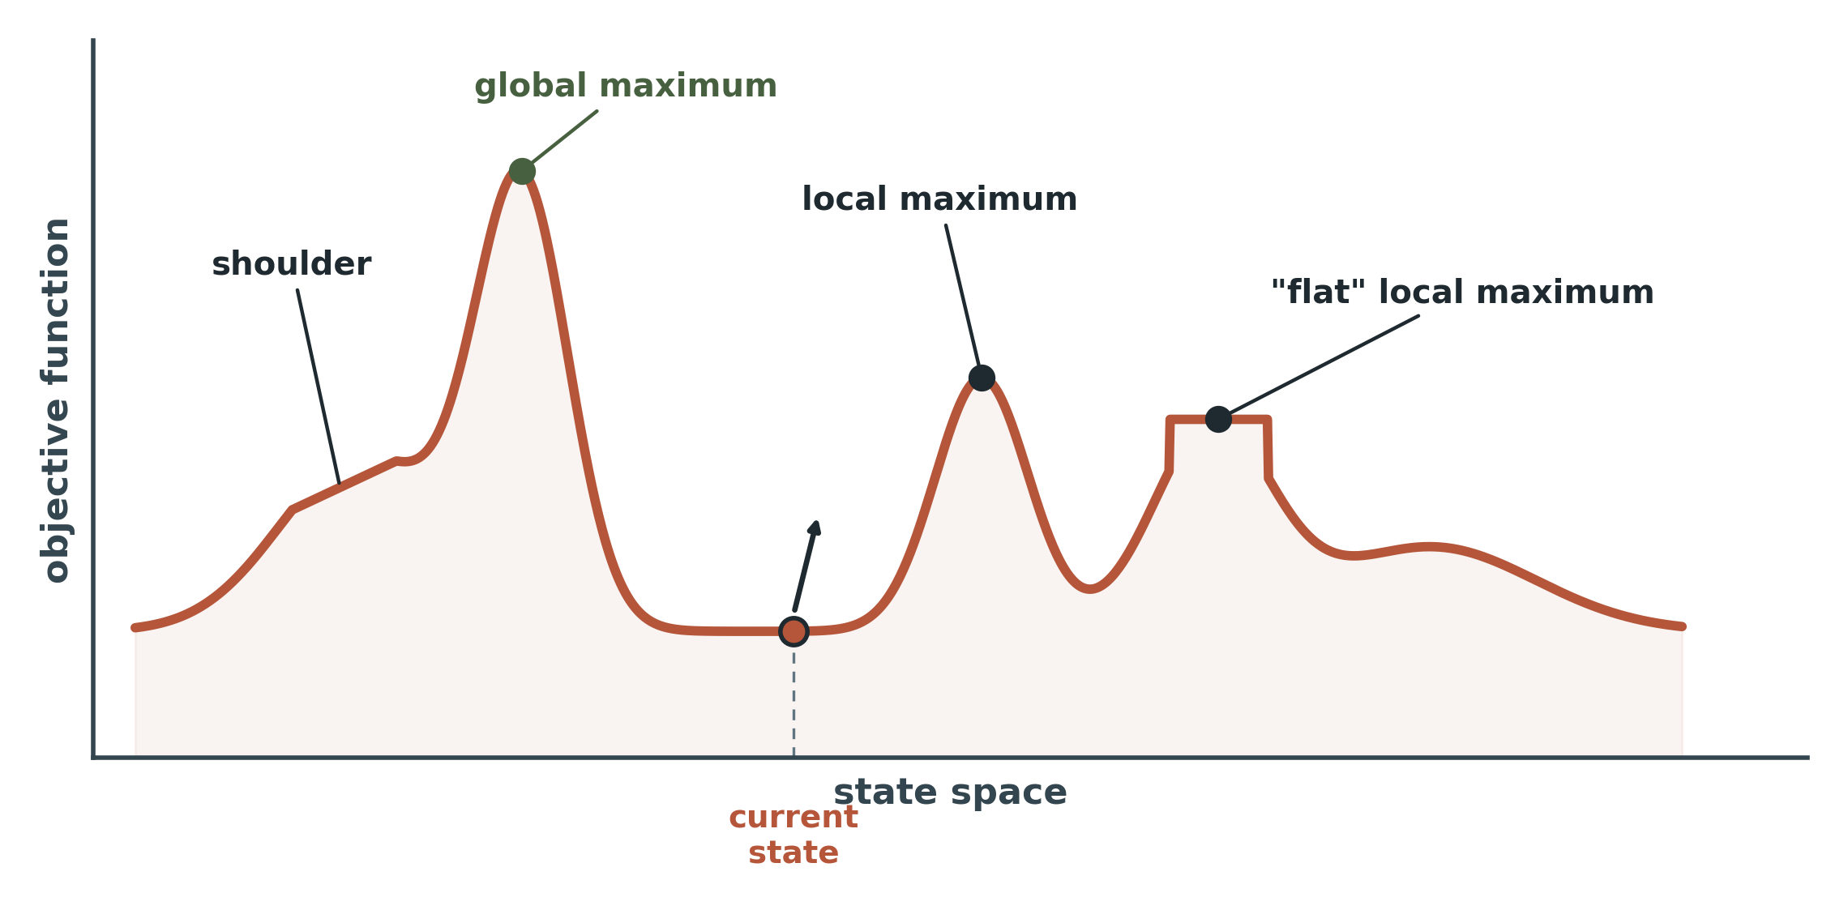
4.1 THE MENTAL MODEL
The state-space landscape
Read the picture this way
x-axis: every state in the space, laid out side by side.
y-axis: the elevation of that state — the value of the objective function.
A complete-state formulation means every x on this axis is a legal board, not a partial one.
This one picture is the entire section. Hill climbing, simulated annealing, beam search, and genetic algorithms are four different answers to the same question: given that you can only feel the ground under your feet, how do you find the highest peak?
COMP 469 · Introduction to Artificial Intelligence · CSU Channel Islands
11
Notes:
Spend real time here — three minutes minimum. Everything downstream is a callback to this figure. Walk the five labelled features in order: global maximum, shoulder, local maximum, flat local maximum, current state. Ask which of the five the agent can distinguish from where it stands. Answer: none of them. It knows only its own elevation and its neighbours' elevations. That is the whole difficulty.

Slide 12
4.1 TERMINOLOGY
Hill climbing and gradient descent are one algorithm
Elevation = objective
Elevation = cost
Higher is better. The aim is the highest peak — a global maximum. We call the process hill climbing.
Lower is better. The aim is the lowest valley — a global minimum. We call the process gradient descent.
maximise f(x)
minimise f(x) = maximise −f(x)
Why you should care about a naming convention
Every gradient descent step you will ever write in a machine learning course is the algorithm on the left with the sign flipped. When we reach Section 4.2 you will see the update rule x ← x − α∇f(x) and it will be the same three lines of pseudocode you are about to read for hill climbing.
COMP 469 · Introduction to Artificial Intelligence · CSU Channel Islands
12
Notes:
Plant this flag early. Students who have already seen gradient descent in a stats or ML context will relax visibly once they realise this is the same thing. Students who have not will have a hook for later. Do not let anyone leave believing hill climbing and gradient descent are different algorithms.

Slide 13
4.1 METHOD
Formulating a local search problem
A complete-state formulation: every state has all the components of a solution, but they might not all be in the right place.
States
A complete configuration, never a partial one.
8 queens on the board, one per column.
Initial state
Usually chosen at random.
8 random rows, one per column.
Successors
Small local modifications of the current state.
Move one queen within its column: 8 × 7 = 56 successors.
Value function
A number scoring the state. Cheap to evaluate.
h = number of pairs of queens attacking each other.
Termination
No neighbour improves, or a threshold is met.
h = 0, or no successor has lower h.
8-queens instantiation shown in rust.
COMP 469 · Introduction to Artificial Intelligence · CSU Channel Islands
13
Notes:
Have the class fill in the right-hand column for a second problem before you show it — travelling salesperson works well. States: a complete tour. Successors: swap two cities, or reverse a subsequence (2-opt). Value: negative tour length. The 56 figure is worth deriving out loud: 8 columns times 7 other rows each. Students who miss this get the branching factor wrong on the exam.

Slide 14

02
Hill-Climbing Search
Section 4.1.1. Keep one current state. On every iteration, move to the neighbour with the highest value. Stop at a peak. It is three lines long, it solves 14% of 8-queens instances, and understanding exactly why it fails is the point of the next half hour.
14
Notes:
Roughly 28 minutes. The arc: algorithm, metaphor, worked example, three failure modes, three fixes, and the arithmetic of restarts.

Slide 15
4.1.1 THE ALGORITHM
Steepest-ascent hill climbing
function HILL-CLIMBING(problem) returns a state
current ← problem.INITIAL
loop do
neighbor ← a highest-valued successor state of current
if VALUE(neighbor) ≤ VALUE(current) then
return current
current ← neighbor
Three properties worth naming
One current state. The loop never allocates. Memory is O(1) plus whatever the successor function needs.
No lookahead. The algorithm does not look beyond the immediate neighbours of the current state. It cannot see two moves ahead, ever.
No history. It does not know where it has been, so it cannot detect that it is revisiting states or wandering in circles.
Termination is where the trouble lives: the algorithm stops when no neighbour is better — which says nothing whatsoever about whether the current state is good.
COMP 469 · Introduction to Artificial Intelligence · CSU Channel Islands
15
Notes:
Walk the loop once out loud with a volunteer state before advancing. The subtle line is the termination test: '≤' rather than '<'. With ≤, a sideways move to an equal-valued neighbour terminates the search. Change it to '<' and the algorithm will happily wander a plateau forever. We come back to that choice in about ten minutes when we allow sideways moves deliberately.

Slide 16
4.1.1 THE METAPHOR
Everest, in thick fog, with amnesia
“This resembles trying to find the top of Mount Everest in a thick fog while suffering from amnesia.”
Everest
Thick fog
Amnesia
The objective is real and there is a genuine highest point. The difficulty is not that the problem is ill-posed.
You can feel the slope immediately around you and nothing else. No view of the summit, no map, no lookahead.
You do not remember where you have already been. No reached set, no frontier, no way to detect a loop.
Each clause of the metaphor maps onto a design decision, and each design decision is what buys the constant memory. The fog is not a bug in hill climbing — it is the price of the memory guarantee.
COMP 469 · Introduction to Artificial Intelligence · CSU Channel Islands
16
Notes:
Students enjoy this line, so use it — but immediately convert the joke into the three design consequences on the cards, otherwise it stays a joke. Good question to pose: which of the three would you relax first if you were allowed to spend memory? Most students say amnesia (add a tabu list). That is exactly right and it is what tabu search does; mention the name in passing, it is not in 4.1 but it is the obvious next step and comes up in interviews.

Slide 17
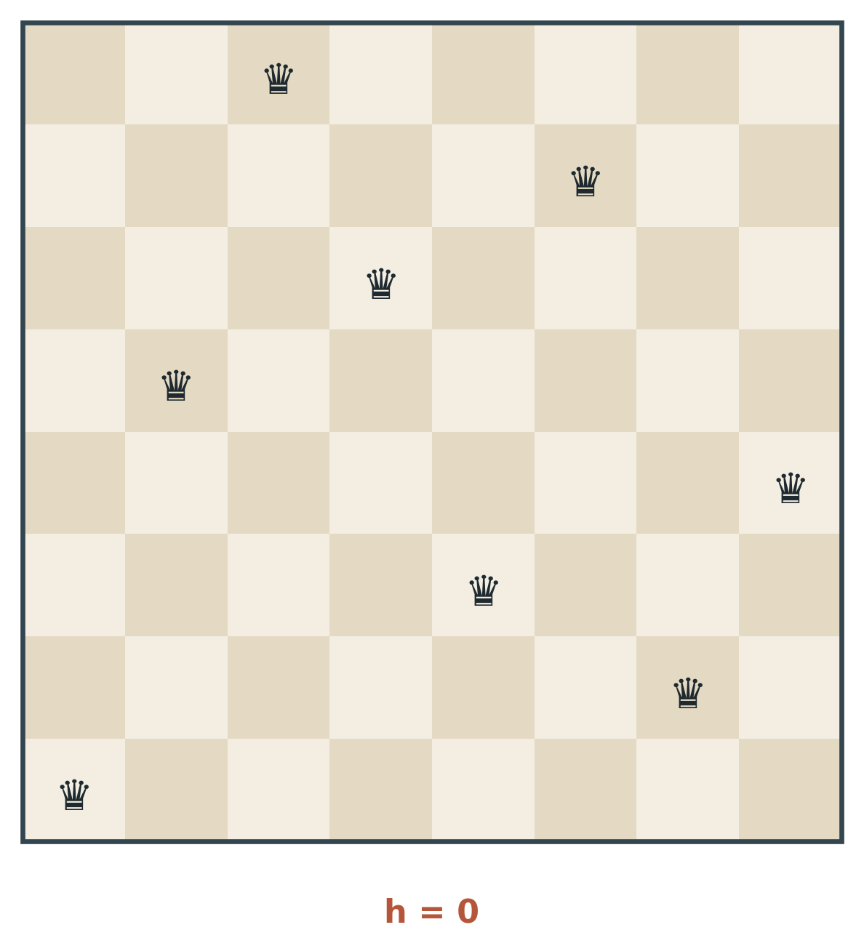
4.1.1 RUNNING EXAMPLE
8-queens as a local search problem
States: every state has 8 queens on the board, one per column. A complete-state formulation.
State space size: 8⁸ ≈ 17 million states.
Initial state: chosen at random.
Successors: all states generated by moving a single queen to another square in the same column.
8 columns × 7 other squares = 56 successors per state.
Heuristic cost function h: the number of pairs of queens that are attacking each other, directly or indirectly.
It counts as an attack if two queens are in the same line, even if there is an intervening piece between them.
h = 0 only for solutions, so we minimise h — hill climbing on −h.
A goal state: h = 0
COMP 469 · Introduction to Artificial Intelligence · CSU Channel Islands
17
Notes:
The intervening-piece rule is the single most common source of wrong h values on homework. Draw a column with three queens in a line on the board and count: that is three attacking pairs, not two. 8^8 is worth writing on the board: 16,777,216. Then point out that we will solve instances of it while storing exactly one board.

Slide 18
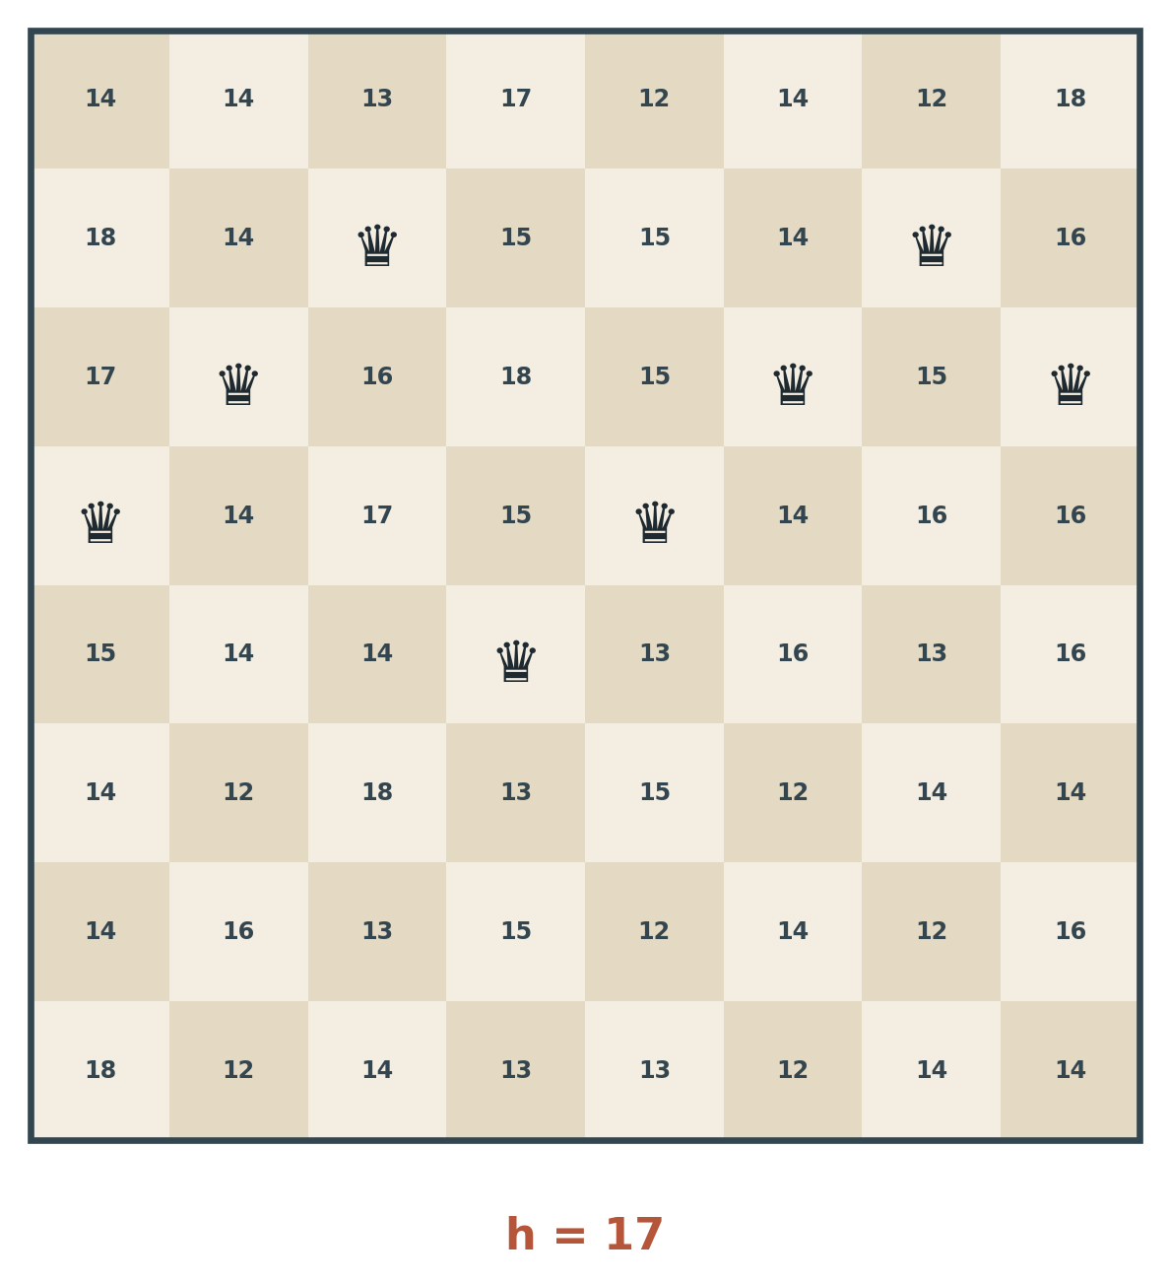
4.1.1 WORKED EXAMPLE
One state, fifty-six successors
Each number is the value of h for the state you would reach by moving the queen in that column to that square.
The current state
h = 17. Seventeen pairs of queens are attacking each other. This board is a long way from a solution but it is a perfectly legal state — that is what complete-state formulation means.
What steepest ascent will do
Scan all 56 numbers. Take the smallest. Move there. Repeat. No tie-breaking rule is specified by the algorithm, so implementations usually break ties at random.
Question for the room: what is the smallest number on this board, and how many squares achieve it?
COMP 469 · Introduction to Artificial Intelligence · CSU Channel Islands
18
Notes:
Give them sixty seconds to hunt for the minimum. This is the moment the algorithm becomes concrete rather than notational. Answer on the next slide: h = 12, achieved by five different squares. Do not reveal it early. If someone shouts 12, ask them how many squares tie for it — almost nobody gets the count.

Slide 19
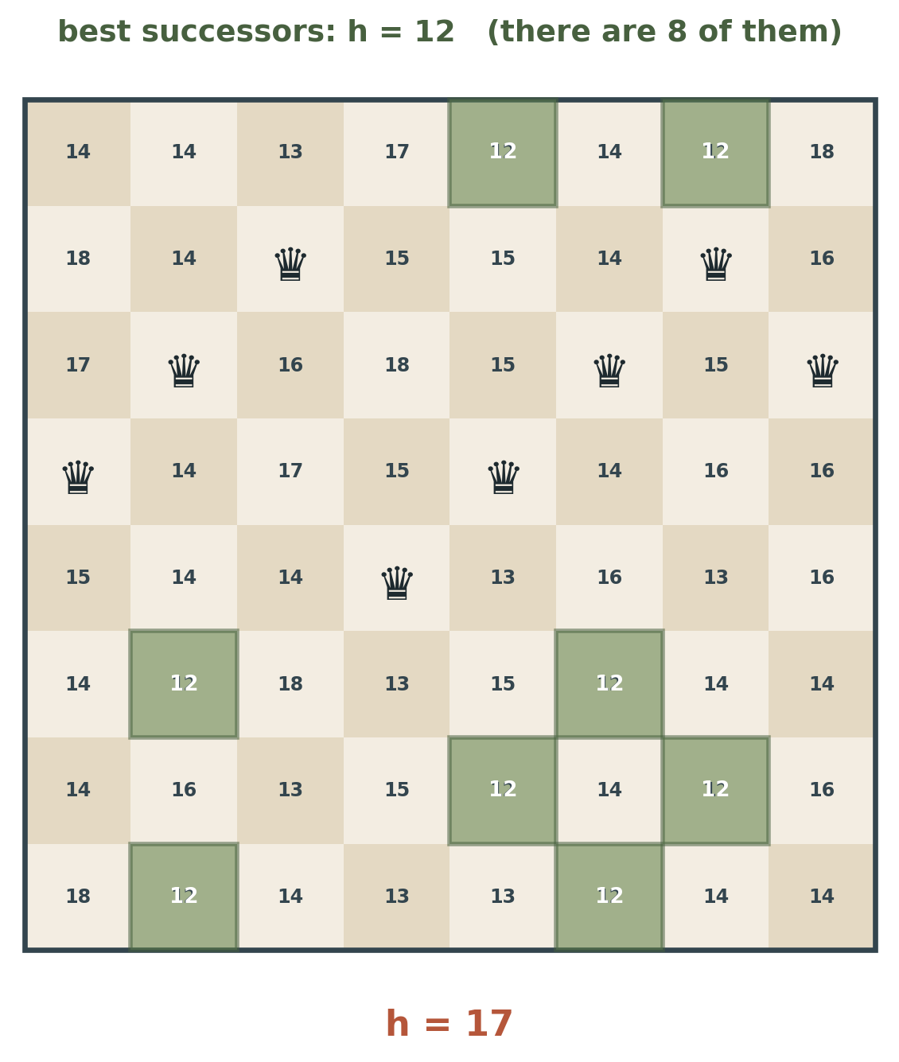
4.1.1 WORKED EXAMPLE
Five ways to move, all equally good
The best successors have h = 12, and there are five of them.
Steepest ascent takes one of the five — the algorithm does not say which, so ties are broken randomly.
From this h = 17 state, it takes just five steps to reach a state with h = 1.
Hill climbing makes rapid progress at the start because it is usually easy to improve a bad state. This is why greedy methods are worth taking seriously.
That h = 1 board is the trap. It is nearly a solution, and every single one of its 56 successors is worse.
COMP 469 · Introduction to Artificial Intelligence · CSU Channel Islands
19
Notes:
The five-tie point matters more than it looks: the choice among the five determines whether this run ends at h = 1 stuck or at h = 0 solved. The algorithm has no principled way to choose. That is a real weakness, not a detail of the presentation. Set up the next slide by saying: five steps from here we hit a board with h = 1 — one attacking pair, one move from perfection — and we will be completely, permanently stuck.

Slide 20
4.1.1 INTERPRETATION
Hill climbing is greedy local search
Hill climbing is sometimes called greedy local search because it grabs a good neighbour state without thinking ahead about where to go next.
Although greed is considered one of the seven deadly sins, greedy algorithms often perform quite well.
Why greed works early
Why greed fails late
Bad states have many defects, so almost any local repair helps. Improvement is cheap and plentiful when h is large.
Near-perfect states have one defect left, and fixing it requires temporarily creating another. Greed refuses to pay that price.
This asymmetry is the whole story of Section 4.1. Every algorithm after hill climbing — sideways moves, restarts, annealing, beam search, crossover — is a different scheme for buying the temporary worsening that greed will not accept.
COMP 469 · Introduction to Artificial Intelligence · CSU Channel Islands
20
Notes:
This is the organising idea of the lecture — say it slowly and consider writing it on the board so it stays up for the next hour. If you want to connect to earlier material: greedy best-first search from Chapter 3 had the same character, and A* fixed it by adding g(n). There is no equivalent fix here, because there is no path to charge a cost to.

Slide 21
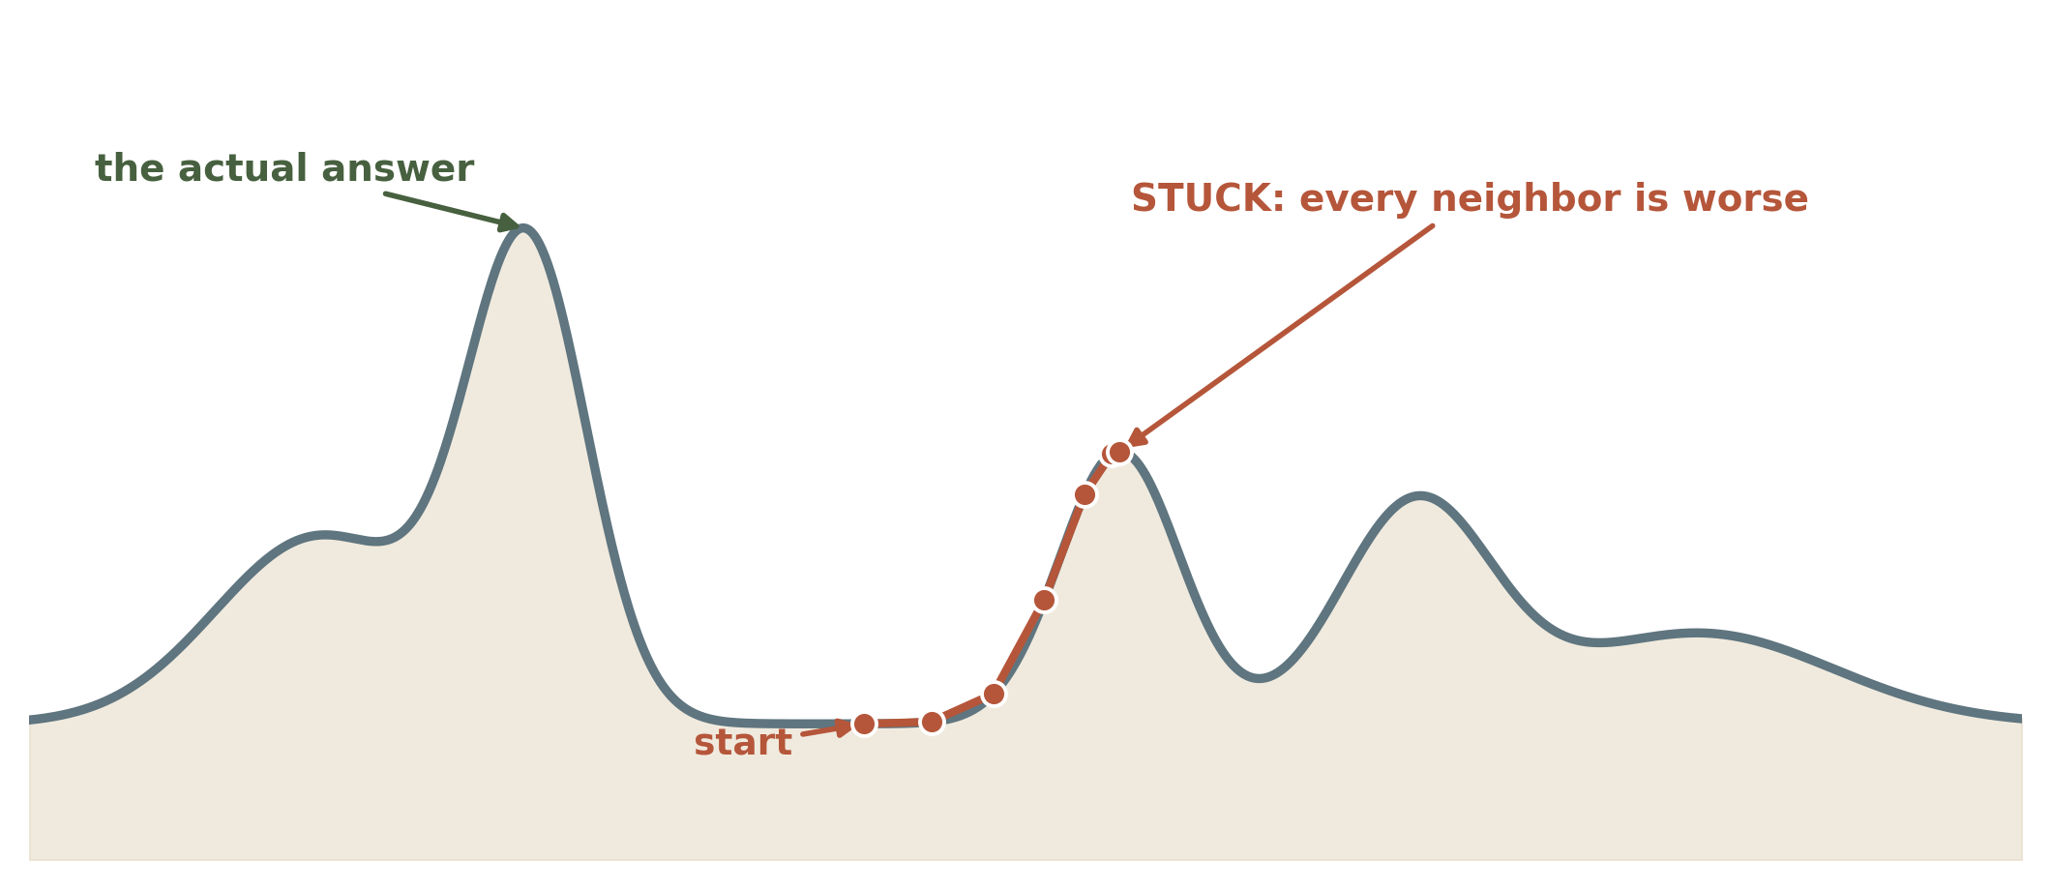
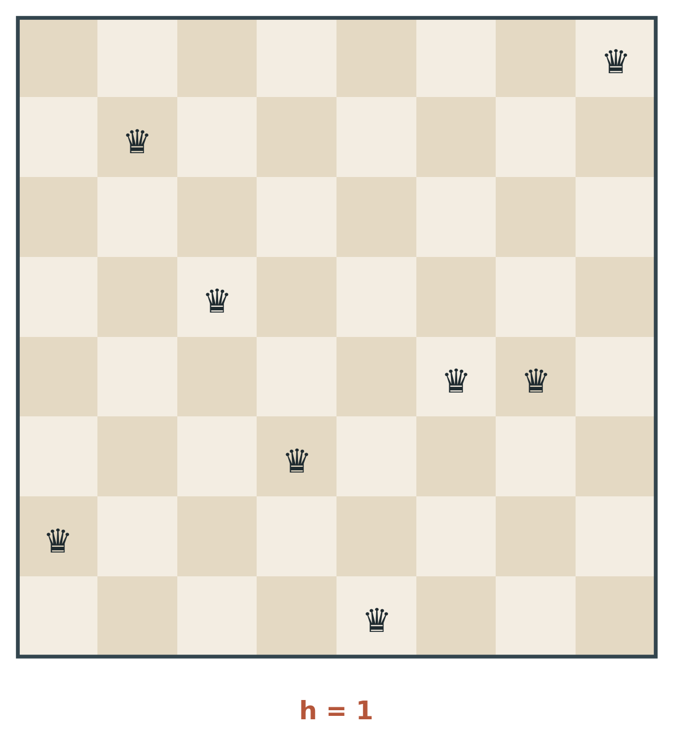
4.1.1 FAILURE MODE 1 OF 3
Local maxima
Definition
A local maximum is a peak that is higher than each of its neighbouring states, but lower than the global maximum.
Hill climbing is drawn upward toward the peak and then has nowhere to go. Every neighbour is worse, so the termination test fires and the algorithm reports success.
The 8-queens instance of exactly this: the board on the left has h = 1 — one attacking pair, one move from a solution — and every one of its 56 successors has h ≥ 2. It is a local minimum for the cost h, and steepest-ascent hill climbing stops there and calls it done.
COMP 469 · Introduction to Artificial Intelligence · CSU Channel Islands
21
Notes:
Hold up the h = 1 board and let the frustration land. One pair. Fifty-six moves available. All of them worse. The deeper point: the algorithm has no way to know the difference between this and a genuine solution, because the only signal it has is 'no neighbour is better' — and that signal is identical in both cases.

Slide 22
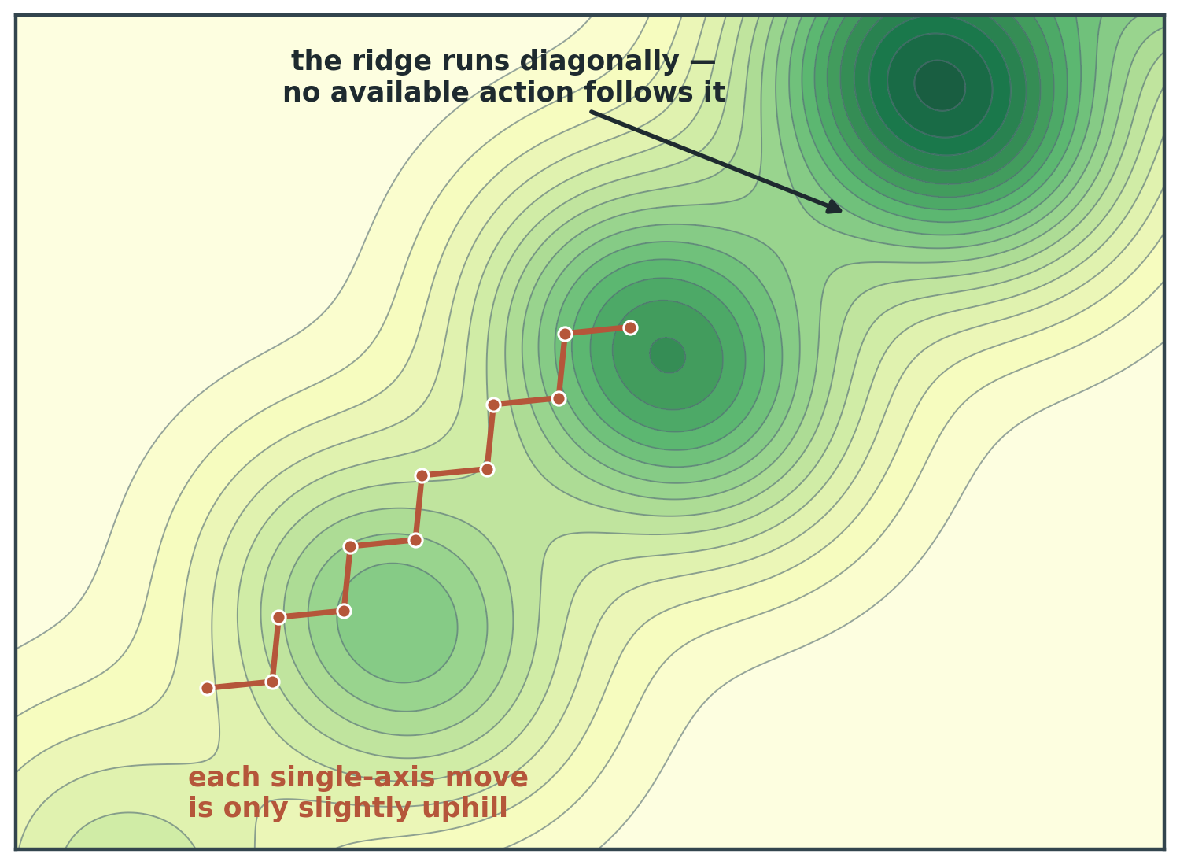
4.1.1 FAILURE MODE 2 OF 3
Ridges
A ridge is a sequence of local maxima that is very difficult for greedy algorithms to navigate.
The terrain does climb toward the summit — but it climbs along a diagonal, and the successor function only offers moves along the axes.
Every available move is either slightly uphill or downhill, so the search zig-zags, taking many steps for little elevation.
Worse: the sequence of small peaks along the ridge means the algorithm can terminate at any one of them.
The lesson
Ridges are not a property of the problem. They are a property of the successor function you chose.
COMP 469 · Introduction to Artificial Intelligence · CSU Channel Islands
22
Notes:
The most valuable takeaway on this slide is on the card: change the successor function and the ridge disappears. If you allow diagonal moves in this landscape, the problem is trivial. This is why the formulation step from slide 12 is not busywork. In practice, redesigning the neighbourhood structure beats redesigning the algorithm more often than students expect.

Slide 23
4.1.1 DESIGN LEVER
Neighbourhood size is a knob, not a given
A ridge is a property of the successor function you chose, not of the problem you were handed.
Small steps
Large steps
Variable steps
A tight neighbourhood tracks local structure faithfully and every improvement is real — but the search feels every small bump and halts at the first one.
A wider neighbourhood steps clean over small local maxima, smoothing the landscape the algorithm perceives — at the risk of stepping over a narrow global optimum too.
Start wide to cross the rough terrain, then narrow as the search settles. The same schedule idea as annealing temperature, applied to distance rather than tolerance.
Why this sits next to the ridge slide
Axis-aligned moves on a diagonal ridge zig-zag; allow diagonal moves and the same landscape is trivial. Redesigning the neighbourhood beats redesigning the algorithm more often than students expect, and it costs no new code — only a different definition of the word neighbour.
COMP 469 · Introduction to Artificial Intelligence · CSU Channel Islands
23
Notes:
Three minutes, immediately after ridges, while the zig-zag picture is still on their retina. The point students miss is that step size is a design variable in DISCRETE local search too, not only in the continuous section. In 8-queens, a two-queen swap is a bigger step than a one-queen move, and it changes which states are local optima. Ask: what happens to the h = 1 trap from slide 21 if a successor is allowed to move two queens at once? It stops being a local minimum. That is the whole idea in one sentence. Flag the forward reference: the variable-step card is the discrete rehearsal for the annealing schedule and for the learning rate in 4.2.

Slide 24
4.1.1 FAILURE MODE 3 OF 3
Plateaus: shoulders and flat local maxima
A plateau is a flat area of the state-space landscape. Crucially, there are two kinds, and from the inside they look identical.
Shoulder
Flat local maximum
A flat region from which progress is still possible — the ground rises again on the far side. If the algorithm keeps walking, it escapes and continues climbing.
Stopping here is a wasted opportunity.
A flat region with no uphill exit anywhere on it. If the algorithm keeps walking, it wanders forever and never terminates.
Walking here is a wasted eternity.
The dilemma: from the current state, a shoulder and a flat local maximum are indistinguishable. Both look like “all my neighbours have exactly my value.” Any policy you adopt is right on one and wrong on the other.
COMP 469 · Introduction to Artificial Intelligence · CSU Channel Islands
24
Notes:
This slide sets up the sideways-move fix two slides from now, so do not resolve the dilemma yet. Let it sit. Good exam-style question to ask: give a policy that is guaranteed to terminate and guaranteed to escape every shoulder. There isn't one that does both without additional information. The practical compromise (cap the sideways moves) is on slide 24.

Slide 25
4.1.1 EMPIRICAL PERFORMANCE
What plain hill climbing actually achieves
Starting from a randomly generated 8-queens state, steepest-ascent hill climbing:
14%
4
3
8⁸ ≈ 17M
of problem instances solved
(it gets stuck 86% of the time)
steps on average
when it succeeds
steps on average
when it gets stuck
states in the space,
and we store exactly one
Read those numbers together, not separately. A 14% success rate sounds like a failure — until you notice the algorithm reaches its answer, right or wrong, in three or four moves through a seventeen-million-state space.
Cheap and usually wrong beats expensive and always right, provided you can afford to try again. That single observation motivates the next four slides.
COMP 469 · Introduction to Artificial Intelligence · CSU Channel Islands
25
Notes:
Do not let the 14% land as 'hill climbing is bad'. The interesting number is the 3-4 steps. An algorithm that terminates in four steps can be run two hundred times for less than the cost of one systematic search. That framing is what makes random restarts feel inevitable rather than like a patch.

Slide 26
4.1.1 FIX 1 OF 3
Allow sideways moves
The idea: when we reach a plateau, keep going. Allow a move to a neighbour of equal value, in the hope that the plateau is really a shoulder.
The danger: if we are actually on a flat local maximum, this wanders on the plateau forever.
The compromise: limit the number of consecutive sideways moves — stopping after, say, 100.
Solved
Steps if solved
Steps if failed
Steepest ascent, no sideways moves
14%
4
3
Sideways moves allowed (limit 100)
94%
≈ 21
≈ 64
Success comes at a cost. Solving seven times as many instances costs roughly five times as many steps per success and twenty times as many per failure. That trade is almost always worth taking — but notice that it is a trade.
COMP 469 · Introduction to Artificial Intelligence · CSU Channel Islands
26
Notes:
14% to 94% from a one-line change is the single most memorable number in 4.1.1. Make sure it is written down. The implementation detail worth stating: the counter must reset to zero on any strictly uphill move, and the limit is on CONSECUTIVE sideways moves, not total. Students get this wrong when they implement it.

Slide 27
4.1.1 FIX 2 OF 3
Stochastic and first-choice hill climbing
Stochastic hill climbing
First-choice hill climbing
Choose at random from among the uphill moves. The probability of selection can vary with the steepness of the move.
Usually converges more slowly than steepest ascent — but in some landscapes it finds better solutions, because it does not always commit to the same greedy choice.
Generate successors at random, one at a time, until one is better than the current state. Take it immediately.
A good strategy when a state has many successors — thousands, or an unbounded number. You never enumerate the neighbourhood at all.
Remember first-choice hill climbing
It is one of only two algorithms in this entire chapter that survives the move to continuous state spaces in Section 4.2. Steepest ascent requires enumerating the neighbours — and in a continuous space there are infinitely many of them. First-choice hill climbing never needs the full list, so an infinite branching factor does not stop it.
COMP 469 · Introduction to Artificial Intelligence · CSU Channel Islands
27
Notes:
Flag the forward reference on the dark card explicitly — it is the bridge to 4.2 and it comes back in about an hour. The other survivor is simulated annealing, for the same reason: it samples a random successor rather than enumerating. Ask which variant you would use for a state with 10^6 successors. First-choice, obviously. Then ask about 10 successors. Steepest ascent, because enumeration is free and the extra information is worth having.

Slide 28
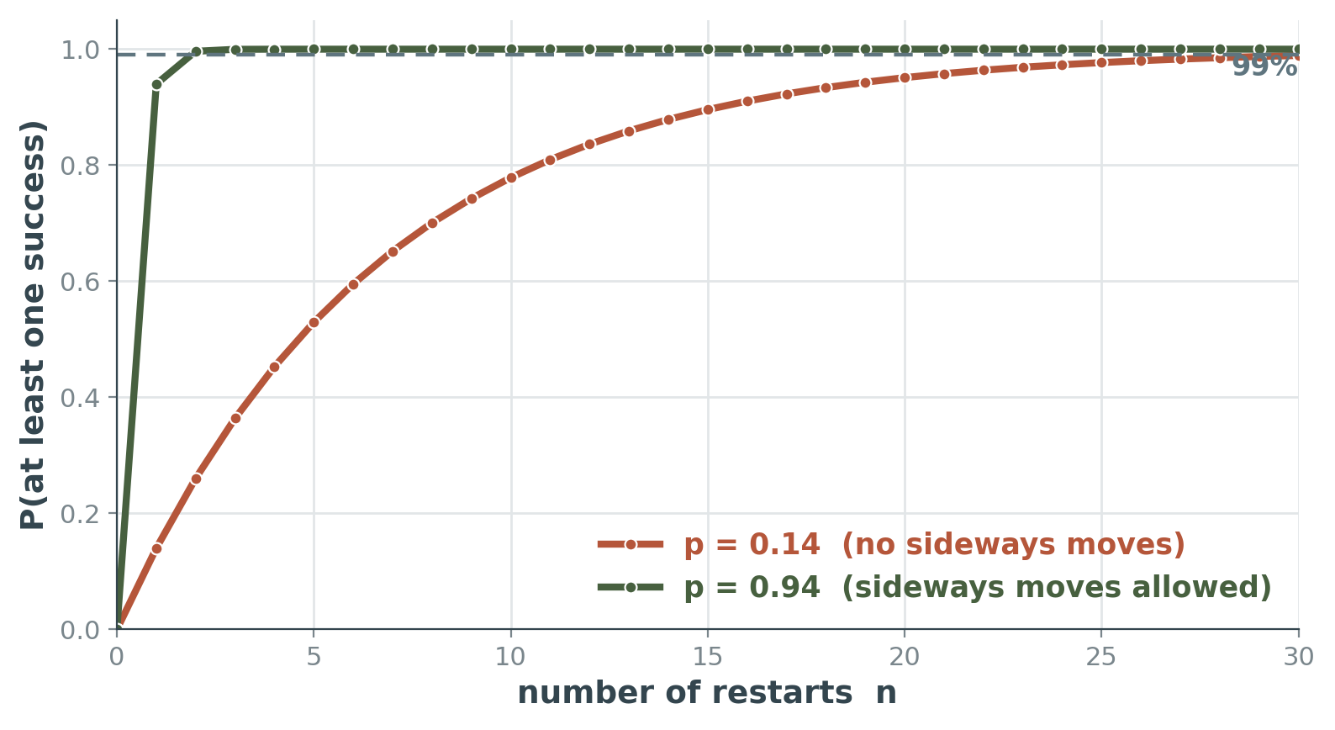
4.1.1 FIX 3 OF 3
Random-restart hill climbing
“If at first you don’t succeed, try, try again.” Conduct a series of hill-climbing searches from randomly generated initial states, until a goal is found.
It is complete with probability 1.
Not complete in the Chapter 3 sense. The guarantee is that as the number of restarts grows without bound, the probability of having found a goal approaches 1 — because eventually a goal state gets generated as an initial state.
If each hill-climbing search has probability p of success, the expected number of restarts required is 1/p.
This is the mean of a geometric distribution. It is the one formula from this section you should be able to write down cold.
The curve on the right is P(at least one success in n restarts) = 1 − (1 − p)ⁿ.
COMP 469 · Introduction to Artificial Intelligence · CSU Channel Islands
28
Notes:
Draw the distinction between 'complete' and 'complete with probability 1' carefully — it shows up on exams as a trap. A student who writes 'random-restart hill climbing is complete' without qualification loses the point. The geometric-distribution connection is worth 30 seconds if your students have had a probability course; skip it if they have not, and just assert 1/p.

Slide 29
4.1.1 WORKED ARITHMETIC
Expected cost of random restarts
Expected total steps = cost of one successful run + (1 − p)/p × cost of one failed run
The second term is the expected number of failures before the first success, times what each failure costs you.
No sideways moves: p ≈ 0.14
Sideways moves allowed: p ≈ 0.94
restarts = 1 / 0.14 ≈ 7
(6 failures + 1 success)
steps = 4 + (0.86/0.14) × 3
= 4 + 6.14 × 3
≈ 22 steps in all
restarts = 1 / 0.94 ≈ 1.06
(almost never restarts)
steps = 21 + (0.06/0.94) × 64
= 21 + 0.064 × 64
≈ 25 steps in all
Twenty-two steps to solve a problem with seventeen million states. And for three million queens, this approach finds solutions in seconds.
COMP 469 · Introduction to Artificial Intelligence · CSU Channel Islands
29
Notes:
Work the left column on the board rather than just showing it — this exact computation, with different numbers, is a standard exam question. The interesting comparison is that the two columns land in almost the same place, 22 vs 25 steps, by completely different routes: many cheap failures versus one expensive success. Ask which you would prefer in a setting where each restart has fixed overhead (setting up a simulation, say). Answer: the right-hand column, because restarts are not free in practice.

Slide 30
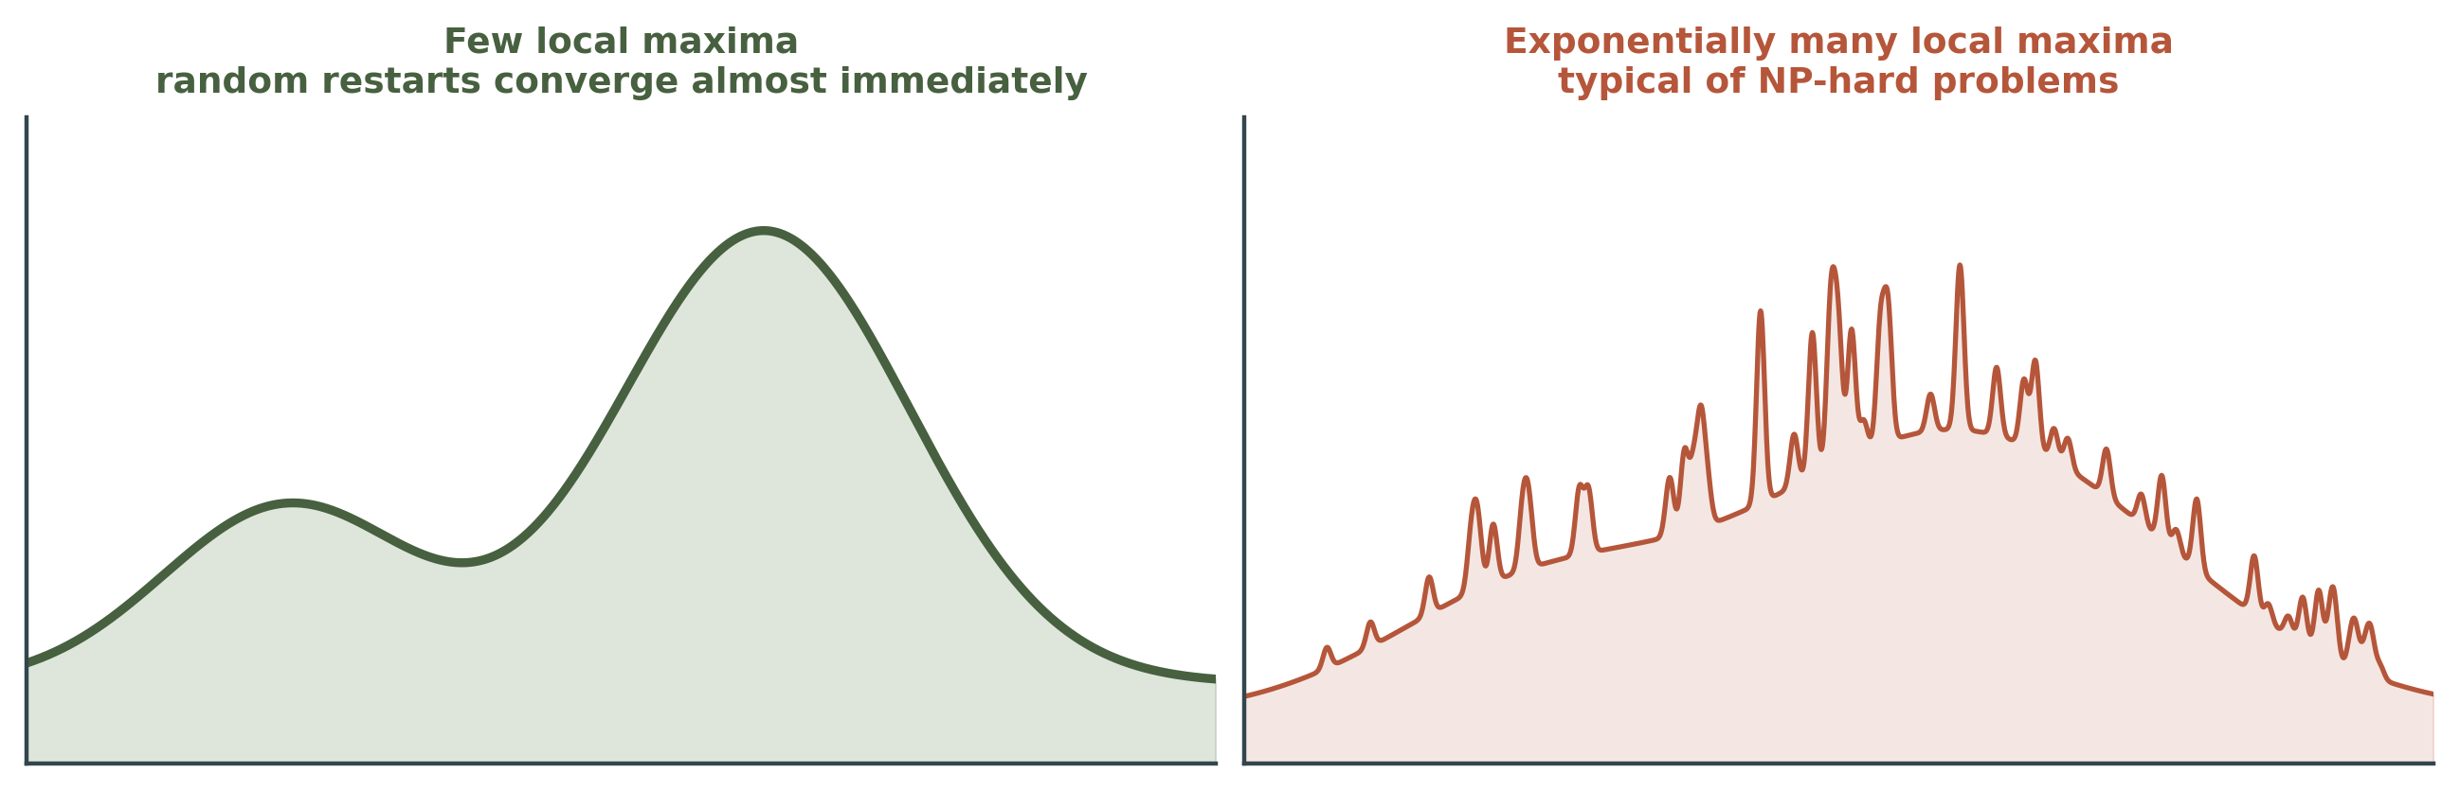
4.1.1 THE CAVEAT
Everything depends on the shape of the landscape
Few local maxima and plateaus: random-restart hill climbing finds a good solution very quickly. 8-queens is this kind of problem — which is exactly why it makes such a flattering demonstration.
Many real problems look more like a widely scattered family of balding porcupines on a flat floor, with miniature porcupines on the tip of each needle. NP-hard problems typically have an exponential number of local maxima.
Even then, a reasonably good local maximum is often found after a few restarts. Good enough, fast, is frequently the right answer.
COMP 469 · Introduction to Artificial Intelligence · CSU Channel Islands
30
Notes:
The porcupine line is Russell and Norvig's, and it is the most useful mental image in the chapter for why benchmark results mislead. Use it verbatim. The practical warning to give: a student who validates a local search method only on 8-queens has learned almost nothing about how it will behave on their actual problem.

Slide 31
4.1.1 BEYOND THE BOOK
Two neighbours of hill climbing worth naming
Tabu search
Min-conflicts
Relax the amnesia instead of the greed. Keep a short list of recently visited states, or recently reversed moves, and forbid them for a fixed number of iterations.
The search is then pushed off a local maximum rather than terminating on it. The cost is memory proportional to the list, not to the state space.
Choose a variable that is currently in conflict, then move it to the value that leaves the fewest conflicts overall.
This is hill climbing with a conflict-driven neighbourhood, and it is how the million-queens result is actually obtained. We meet it properly in Chapter 6 on constraint satisfaction.
Why raise them here
Both are the same three-line loop with exactly one design decision changed: tabu search edits the memory, min-conflicts edits the neighbourhood. Neither appears in Section 4.1, and both are the first things a practitioner reaches for once plain restarts stop being enough.
COMP 469 · Introduction to Artificial Intelligence · CSU Channel Islands
31
Notes:
Three minutes. Neither item is examinable from Section 4.1, so say so — then say why they are worth the time anyway. Tabu search is the answer students themselves propose when you ask which clause of the Everest metaphor they would relax first. Almost everyone says amnesia. Reward that instinct by naming the algorithm it leads to. Min-conflicts is the honest source of the million-queens figure. Plain random-restart hill climbing on the full 56-successor neighbourhood does not get you there; the conflict-driven neighbourhood does. Do not let the earlier slide leave the wrong impression. Both are one-line modifications to code they will write for the exercise, which makes them good optional extensions for a project.

Slide 32
CHECKPOINT
Three questions before we move on
1
A hill-climbing run terminates and reports a state with h = 3. What, precisely, does that tell you about the state?
Only that no single-queen move improves it. Nothing about whether h = 0 is reachable, nothing about how far away it is.
2
You allow sideways moves with no limit. Your program hangs. What happened, and what is the one-line fix?
It reached a flat local maximum and is wandering it forever. Cap the number of consecutive sideways moves — reset the counter on any strictly uphill move.
3
Each hill-climbing run succeeds with p = 0.25, costs 10 steps when it succeeds and 4 when it fails. Expected total steps to first success?
10 + (0.75/0.25) × 4 = 10 + 12 = 22 steps.
COMP 469 · Introduction to Artificial Intelligence · CSU Channel Islands
32
Notes:
Answers are printed in green under each question — hide them with a slide-show annotation, or delete the answer text boxes if you want to project this cold. Run as a two-minute think-pair-share. Question 1 is the one that reveals whether students actually absorbed the difference between 'terminated' and 'solved'. If more than a third get it wrong, revisit slide 20 before continuing.

Slide 33
03
Simulated Annealing
Section 4.1.2. Hill climbing never goes downhill and gets stuck. A random walk goes anywhere and gets nowhere. Simulated annealing interpolates between the two — and the interpolation parameter is called temperature.
33
Notes:
About 17 minutes. This is the most conceptually elegant algorithm in the chapter and the one most often misremembered: students recall 'accept bad moves sometimes' and forget both the exponential and the schedule.

Slide 34
4.1.2 MOTIVATION
Two algorithms, each broken in the opposite way
Pure hill climbing
Pure random walk
Never makes a downhill move toward a state with lower value.
Efficient: every step is progress.
Incomplete: always vulnerable to getting stuck in a local maximum.
Moves to a successor without any concern for its value.
Complete: will eventually stumble upon the global maximum.
Hopeless: extremely inefficient. You will not live to see it.
The obvious question
Can we combine hill climbing with a random walk in a way that yields both efficiency and completeness? Simulated annealing is the answer — and the trick is that the mixture is not fixed. It starts as a random walk and finishes as hill climbing.
COMP 469 · Introduction to Artificial Intelligence · CSU Channel Islands
34
Notes:
The 'not fixed' point is the one students miss. A 50/50 blend of hill climbing and random walk is a bad algorithm. What makes annealing work is that the blend changes over time, and the schedule that changes it is a design parameter you have to tune.

Slide 35
4.1.2 THE METAPHOR
Shake hard, then gently
Annealing in metallurgy
The ping-pong ball picture
The process used to temper or harden metals and glass by heating them to a high temperature and then gradually cooling them, allowing the material to reach a low-energy crystalline state.
Cool too fast and you freeze in defects.
Get a ball into the deepest crevice of a bumpy surface. Let it roll and it rests in a local minimum. Shake the surface and it bounces out — perhaps into a deeper crevice, where it will spend more of its time.
The trick is to shake just hard enough to bounce the ball out of local minima, but not hard enough to dislodge it from the global minimum.
Since you cannot know in advance how hard that is, the solution is to start by shaking hard — at a high temperature — and then gradually reduce the intensity. Note the change of viewpoint: this section minimises cost rather than maximising value, so the pictures are upside down relative to hill climbing.
COMP 469 · Introduction to Artificial Intelligence · CSU Channel Islands
35
Notes:
Flag the viewpoint flip out loud — the textbook switches from hill climbing to gradient descent right here and students who do not notice spend the rest of the section confused about the sign of delta-E. The 'spend more time in deeper crevices' phrase is doing real work: it is a plain-language statement of the Boltzmann distribution we get to in a few slides.

Slide 36
4.1.2 THE ALGORITHM
Simulated annealing
function SIMULATED-ANNEALING(problem, schedule) returns a state
current ← problem.INITIAL
for t = 1 to ∞ do
T ← schedule(t)
if T = 0 then return current
next ← a randomly selected successor of current
ΔE ← VALUE(next) − VALUE(current)
if ΔE > 0 then current ← next
else current ← next only with probability e^(ΔE/T)
Three differences from hill climbing
1. It picks a RANDOM successor, not the best one. No enumeration of the neighbourhood.
2. An improving move (ΔE > 0) is always accepted, exactly as before.
3. A worsening move is accepted with probability e^(ΔE/T), which is less than 1 because ΔE is negative.
Everything else is identical. The schedule is supplied by you, not derived.
Note the loop is over t, not over states: the algorithm is driven by the clock, and the temperature schedule decides when it stops.
COMP 469 · Introduction to Artificial Intelligence · CSU Channel Islands
36
Notes:
Trace two iterations by hand. Take delta-E = -2 and T = 10, then T = 0.5, and compute the two acceptance probabilities. That thirty seconds does more than any amount of explanation. e^(-2/10) = 0.82; e^(-2/0.5) = 0.018. Same move, same badness, wildly different behaviour depending only on where you are in the schedule.

Slide 37
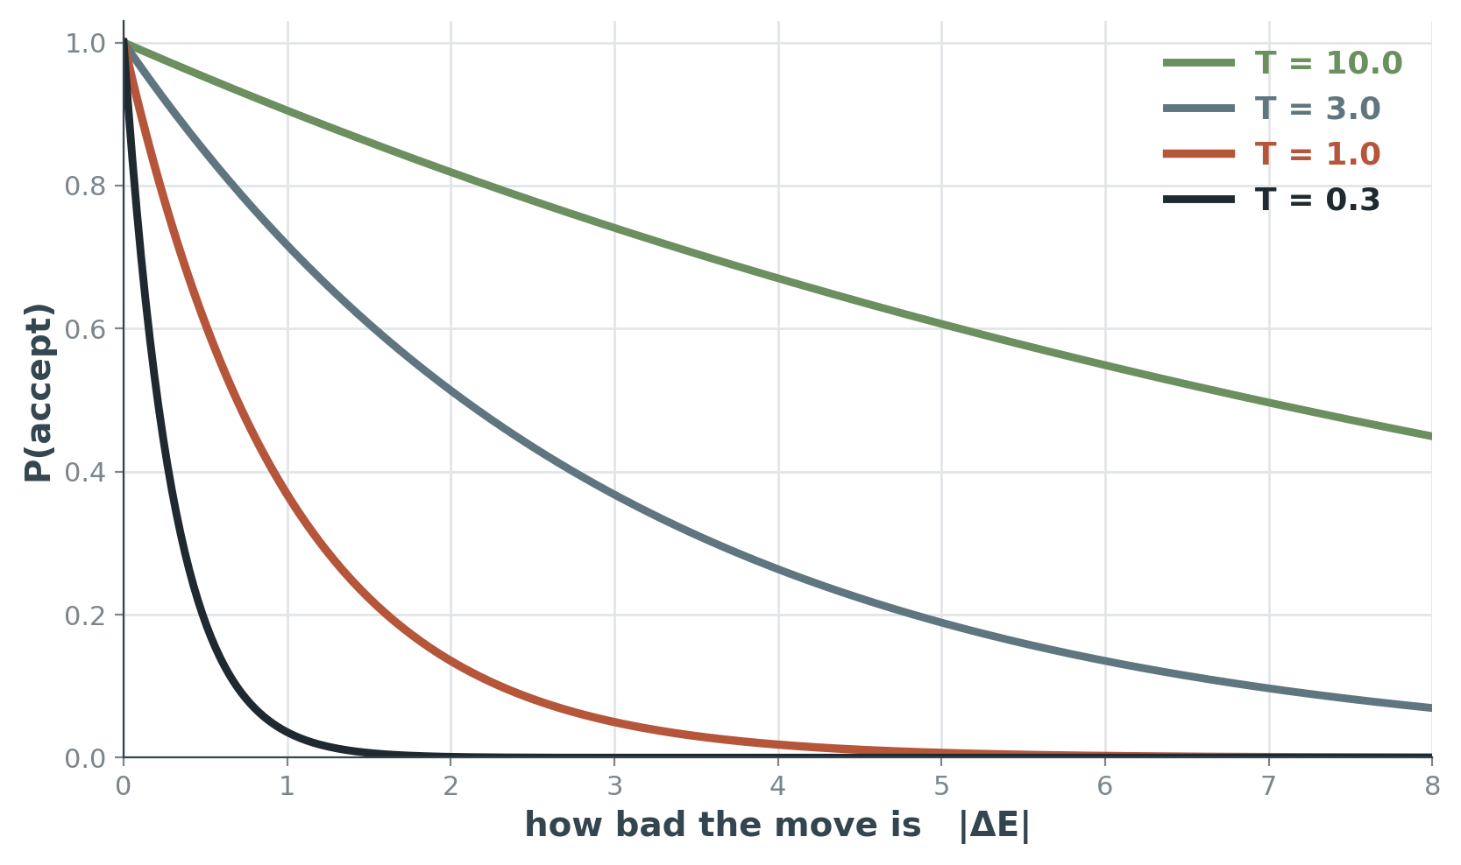
4.1.2 THE ACCEPTANCE RULE
Two things control whether a bad move is taken
How bad the move is
The probability decreases exponentially with the badness of the move — the amount ΔE by which the evaluation is worsened. Slightly bad moves are cheap; catastrophic moves are effectively forbidden.
Where you are in the schedule
The probability also decreases as the temperature T goes down. Bad moves are likely at the start when T is high, and become unlikely as T falls.
At T → ∞ every move is accepted and the algorithm is a pure random walk. At T → 0 no worsening move is ever accepted and the algorithm is stochastic hill climbing. Everything interesting happens in between.
COMP 469 · Introduction to Artificial Intelligence · CSU Channel Islands
37
Notes:
Point at the two ends of the curve family on the graph as you say the last line. The T = 10 curve is nearly flat at 1 (random walk); the T = 0.3 curve collapses to zero almost immediately (hill climbing). This is the slide that makes 'interpolation between two algorithms' concrete rather than metaphorical.

Slide 38
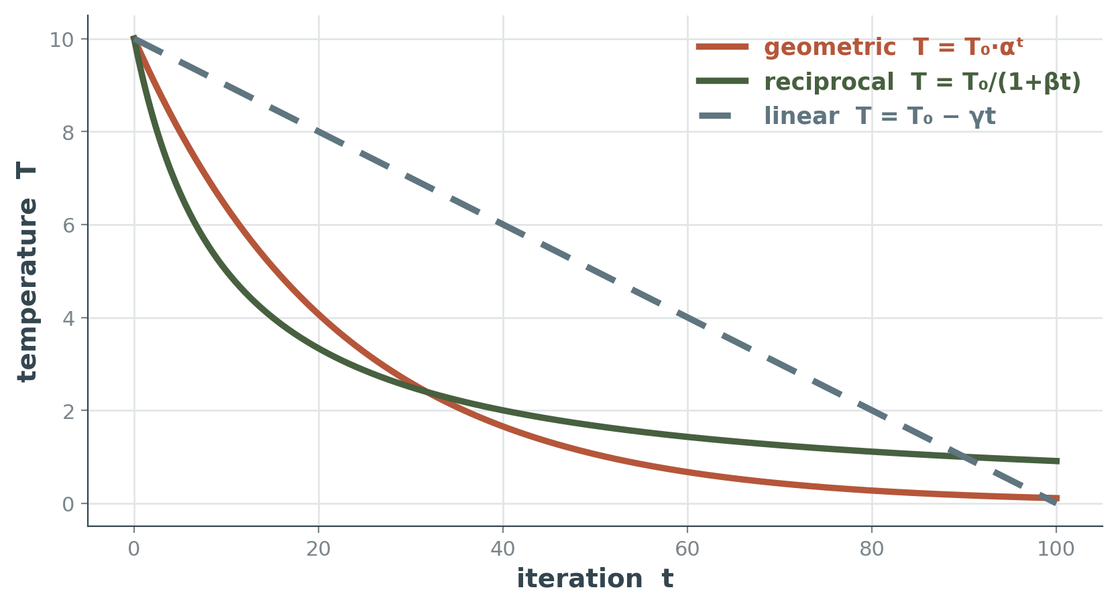
4.1.2 DESIGN CHOICE
The cooling schedule is yours to choose
schedule(t) is a parameter of the algorithm, not part of it. Nothing in the theory tells you which curve to use.
Geometric cooling, T ← αT with α near 0.95, is the default in practice.
You also choose the starting temperature, the number of moves attempted at each temperature, and the stopping rule.
Simulated annealing is pretty sensitive to details.
The same algorithm with a badly tuned schedule is either a random walk that never converges or a hill climber that gets stuck. Budget time for tuning.
A practical starting point
Set T₀ so that roughly 80% of worsening moves are accepted at the start, then cool geometrically until the acceptance rate falls below a few percent. Tune from there.
COMP 469 · Introduction to Artificial Intelligence · CSU Channel Islands
38
Notes:
Be honest that this is the least principled part of the algorithm. Students who implement annealing for a project and get poor results almost always have a schedule problem, not a code problem. The 80%-acceptance heuristic for choosing T-zero is standard practice and is not in the textbook; it is worth giving them because it makes their projects work.

Slide 39
4.1.2 WORKED EXAMPLE
Accept or reject? Run the numbers
Minimising cost. A proposed move changes the cost by the amount shown. Recall ΔE = VALUE(next) − VALUE(current), so an increase in cost gives a negative ΔE.
Move
ΔE
T = 50
T = 10
T = 1
T = 0.1
Improves the state
+3
always
always
always
always
Slightly worse
−1
0.98
0.90
0.37
0.00005
Clearly worse
−5
0.90
0.61
0.007
≈ 0
Much worse
−20
0.67
0.14
2×10⁻⁹
≈ 0
Read the table across a row: the same move goes from routine to impossible as the system cools. Read it down a column: at any fixed temperature, badness is punished exponentially. Both readings matter.
COMP 469 · Introduction to Artificial Intelligence · CSU Channel Islands
39
Notes:
Have students verify one cell with a calculator: e^(-5/10) = 0.607. That single check converts the formula from decoration into arithmetic they trust. Note the bottom-right corner: at T = 0.1, even a mildly worse move is accepted about once in twenty thousand attempts. The algorithm has effectively become hill climbing, which is exactly the intent.

Slide 40
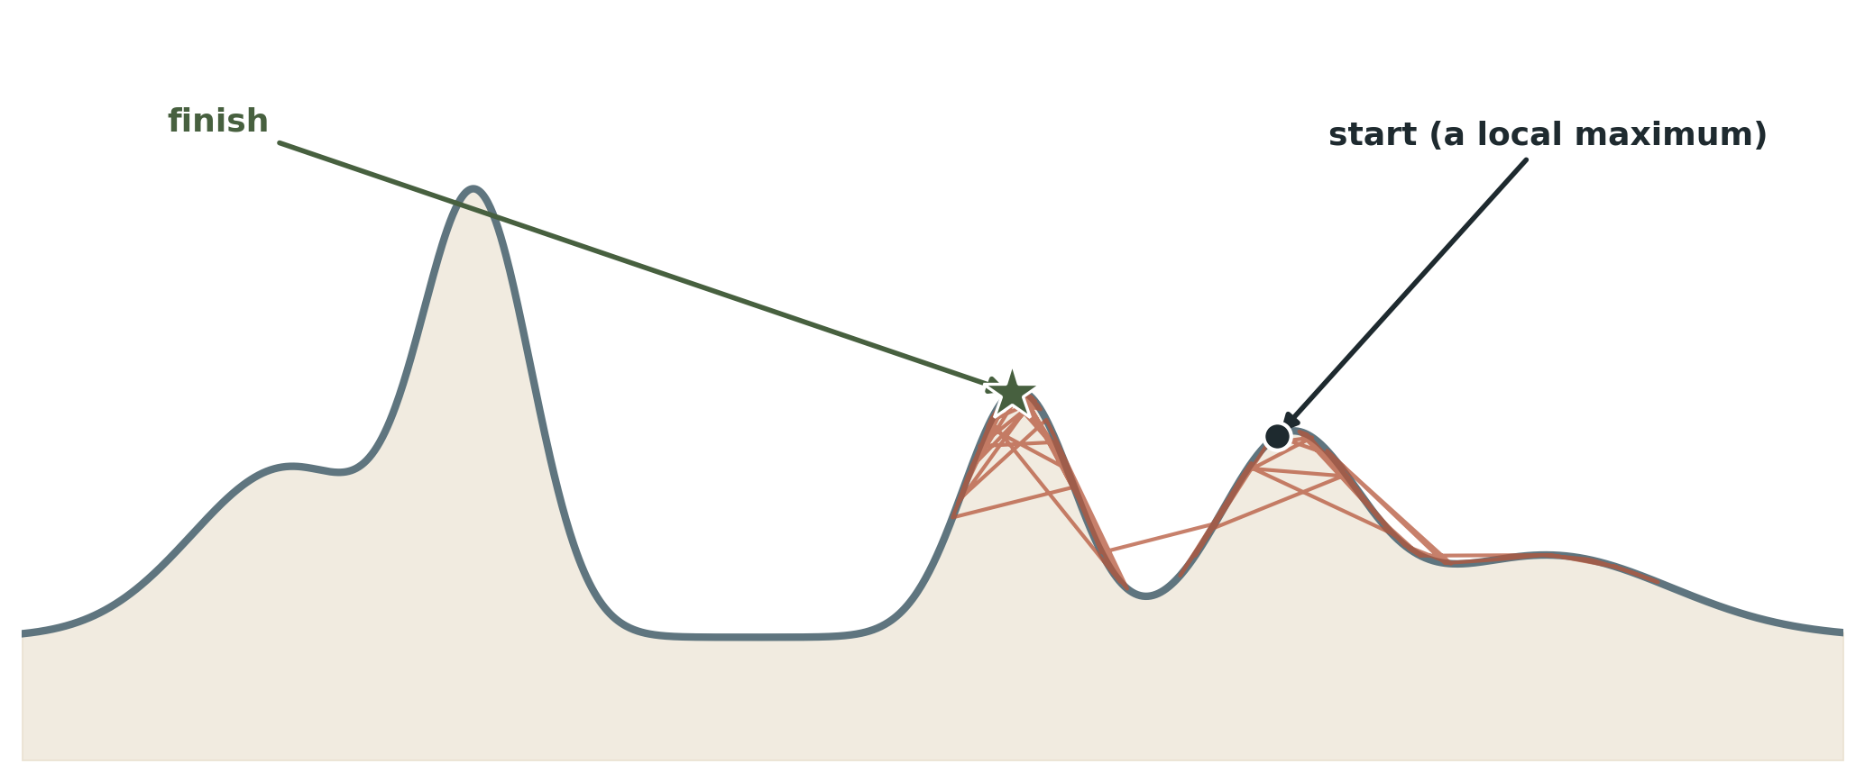
4.1.2 A RUN
Annealing escaping a local maximum
The run starts deliberately trapped, on the local maximum that defeated plain hill climbing on slide 20.
Early, when T is high, the state wanders widely — including well downhill. That wandering is what carries it across the valley.
Late, when T is low, the trajectory tightens onto whichever peak it happens to be near and stays there. There is no guarantee that peak is the global one; there is only a good chance.
COMP 469 · Introduction to Artificial Intelligence · CSU Channel Islands
40
Notes:
Run this live if you have a demo handy — watching the state jump downhill early and then settle is more convincing than a static trace. Emphasise the last bullet. A single annealing run is still a gamble. What annealing buys is a much better gamble than hill climbing offers, not a certainty.

Slide 41
4.1.2 THEORY AND ITS FINE PRINT
The convergence guarantee, honestly stated
If the schedule lowers T to 0 slowly enough, then a property of the Boltzmann distribution, e^(ΔE/T), is that all the probability becomes concentrated on the global maxima, which the algorithm will find with probability approaching 1.
Three reasons not to get excited
“Slowly enough” may mean exponentially slowly
Escapes get exponentially unlikely
The baseline has the same guarantee
The theorem is true and the schedule it requires can be slower than enumerating the entire state space. Practical schedules do not satisfy it.
The more downhill steps you need to escape a local optimum, the less likely you are to ever make them all in a row.
Random-restart hill climbing also converges to the optimal state with probability 1, and it is far simpler. The guarantee alone is not a reason to prefer annealing.
So is this convergence an interesting guarantee? Not by itself. Annealing earns its place empirically — it works well on real problems — not because of the theorem.
COMP 469 · Introduction to Artificial Intelligence · CSU Channel Islands
41
Notes:
This slide is a lesson in reading theory critically, and it is worth saying so explicitly. The convergence result is genuinely true, genuinely famous, and almost entirely useless as a reason to choose the algorithm. Good discussion prompt: what WOULD be an interesting guarantee here? Something like 'within a factor of two of optimal in polynomial time' — which for most of these problems does not exist.

Slide 42
4.1.2 IN PRACTICE
Where simulated annealing is actually used
VLSI layout
Scheduling and configuration
Simulated annealing was used to solve VLSI layout problems beginning in the 1980s, and it remains a workhorse for placement and routing.
The fit is exact: astronomically many legal layouts, a cheap cost function, and no interest whatsoever in how the layout was found.
Applied widely to factory scheduling and other large-scale optimization tasks, and to any optimal-configuration problem where the constraints are messy enough that specialised solvers do not apply.
Annealing is often the method of last resort — and last resorts get used.
When to reach for it
You have a huge configuration space, a cheap-to-evaluate cost function, no useful gradient, and no problem structure that a specialised solver could exploit. You can accept a good answer rather than a proven-optimal one, and you can afford the tuning time the schedule demands.
If a specialised algorithm exists for your problem — a matching algorithm, a linear program, a SAT solver — use that instead. Annealing is general precisely because it assumes nothing, and assuming nothing is expensive.
COMP 469 · Introduction to Artificial Intelligence · CSU Channel Islands
42
Notes:
The 'method of last resort' framing is honest and students appreciate it. Annealing is not the best algorithm for any specific well-structured problem; it is a reasonable algorithm for problems with no structure to exploit. If anyone asks about quantum annealing: acknowledge it exists, note it targets the same problem class, and move on. It is well outside 4.1.2.

Slide 43
Break
Ten minutes.
So far: one current state, moved greedily (hill climbing) or stochastically with a cooling schedule (simulated annealing).
After the break: what changes when you keep k states instead of one — and what happens when those k states are allowed to combine.
43
Notes:
Ten minutes. Use the last minute before the break to take questions on annealing specifically — it is the topic students most often want to ask about privately.

Slide 44
04
Local Beam Search
Section 4.1.3. Keeping one state in memory is an extreme reaction to a memory limit. Keep k instead — and then notice that the k searches, if you let them share, are no longer independent.
44
Notes:
About 12 minutes. Short section, but it is the conceptual bridge to evolutionary algorithms, so do not rush the 'not k parallel restarts' point.

Slide 45
4.1.3 THE ALGORITHM
Local beam search
LOCAL-BEAM-SEARCH(problem, k)
states ← k randomly generated states
loop do
if any state in states is a goal then return it
succ ← all successors of all k states
states ← the k best members of succ
What to notice
The successors of all k states go into ONE pool, and the k best are drawn from that pool.
Nothing requires the survivors to be spread evenly across the k lineages. All k survivors may descend from a single one of the current states.
That detail is the entire difference between beam search and running k searches side by side — and it is both the strength and the weakness of the algorithm.
k = 1 recovers hill climbing. k = ∞ is close to breadth-first search on the value ordering. The interesting behaviour is at small k.
COMP 469 · Introduction to Artificial Intelligence · CSU Channel Islands
45
Notes:
The single pool is the crux. Write the pool on the board as one long list of k times b successors, then draw a line after the k-th best. Ask which original states contributed. Usually one or two. Note for students who saw beam search in a different course: this is LOCAL beam search over states, not the beam search used for decoding sequences, though the pruning idea is the same.

Slide 46
4.1.3 THE KEY DISTINCTION
This is not k random restarts in parallel
k random restarts
Local beam search
Each search process runs independently of the others. A run that lands in a hopeless region of the space grinds on to its own local maximum regardless of what the other runs have discovered.
All of the compute spent in that hopeless region is wasted.
Useful information is passed among the parallel search threads. The states that generate the best successors say to the others, “Come over here, the grass is greener!”
The algorithm quickly abandons unfruitful searches and moves its resources to where the most progress is being made.
Where the communication actually happens
There is no message passing in the pseudocode. The communication is a side effect of the shared pool: a lineage that produces poor successors simply loses its slots to a lineage that produces good ones. Selection over a common pool IS the communication channel.
Hold that thought — it is precisely the mechanism that evolutionary algorithms generalise in the next section.
COMP 469 · Introduction to Artificial Intelligence · CSU Channel Islands
46
Notes:
This is the slide students most often get wrong on exams: 'local beam search is just k parallel hill climbers' is a very tempting and very wrong answer. Make the mechanism explicit — the resource reallocation is implicit in the selection step, not in any explicit communication. That framing makes the jump to genetic algorithms feel like a small step rather than a new topic.

Slide 47
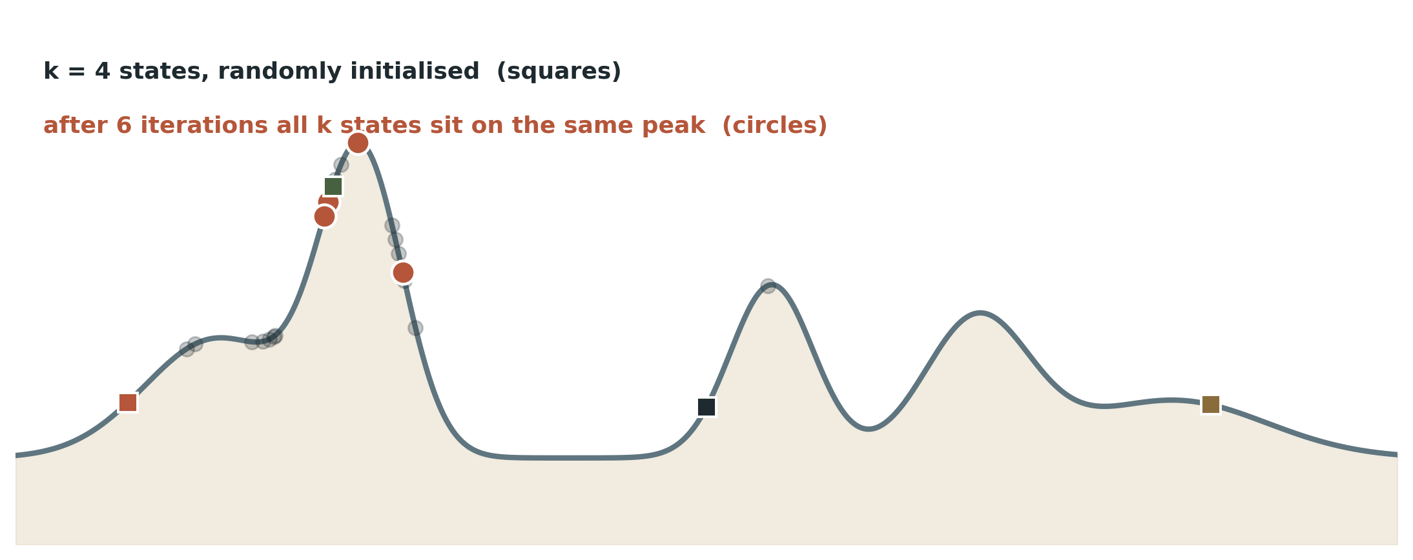
4.1.3 FAILURE MODE
The k states collapse into one region
Local beam search can suffer from a lack of diversity among the k states: they become clustered in a small region of the state space, making the search little more than a k-times-slower version of hill climbing.
COMP 469 · Introduction to Artificial Intelligence · CSU Channel Islands
47
Notes:
The failure is the mirror image of the strength. Aggressive resource reallocation is exactly what makes the algorithm efficient, and exactly what makes it collapse. Ask: with k = 4 and all four states on the same peak, what have you gained over hill climbing? Nothing, and you are paying four times the successor-generation cost. That sets up stochastic beam search perfectly.

Slide 48
4.1.3 THE FIX
Stochastic beam search
Instead of choosing the top k successors, choose successors with probability proportional to the successor’s value.
A merely-good successor in an unexplored region now has a real chance of surviving, so the population stays spread out.
This is analogous to stochastic hill climbing, and it trades a little greed for a lot of diversity.
Read that sentence again
A population of k individuals. Successors generated from them. Survival with probability proportional to fitness. Repeat.
That is natural selection. Stochastic beam search is asexual evolution: each individual produces offspring on its own, and fitness decides who is represented in the next generation. Add one ingredient — offspring produced from two parents rather than one — and stochastic beam search becomes a genetic algorithm.
Section 4.1.4 is that one ingredient.
COMP 469 · Introduction to Artificial Intelligence · CSU Channel Islands
48
Notes:
Deliver the reveal deliberately — pause after 'That is natural selection.' Students who see the connection themselves remember evolutionary algorithms as a special case rather than as a separate topic to memorise. The textbook makes the same move: it defines evolutionary algorithms as variants of stochastic beam search, with the mixing number rho = 1 recovering stochastic beam search exactly.

Slide 49
4.1 CONSOLIDATION
Four algorithms, four positions on the same trade-off
Algorithm
States held
Escapes local maxima by
Diversity
Main weakness
Steepest-ascent hill climbing
1
nothing — it does not
none
stops at the first local maximum
Hill climbing + sideways moves
1
crossing plateaus
none
loops on flat local maxima without a cap
Random-restart hill climbing
1
starting over somewhere new
across runs, not within
discards everything it learned each restart
Simulated annealing
1
accepting bad moves early
over time, not space
sensitive to the cooling schedule
Local beam search
k
having started in k places
within a generation
the k states collapse together
Stochastic beam search
k
probabilistic survival
maintained deliberately
slower to converge than plain beam
Every row is the same trade: how much are you willing to spend, in memory or in wasted moves, to avoid committing to the first peak you find?
COMP 469 · Introduction to Artificial Intelligence · CSU Channel Islands
49
Notes:
Good slide to photograph — tell them so. It is also a good exam-review artifact. If time is short this can be delivered in 45 seconds by reading only the 'escapes local maxima by' column top to bottom. That column is the spine of the whole section.

Slide 50
05
Evolutionary Algorithms
Section 4.1.4. Variants of stochastic beam search explicitly motivated by the metaphor of natural selection: a population of individuals, in which the fittest produce offspring that populate the next generation.
50
Notes:
About 20 minutes. Resist the temptation to spend it on biology. The examinable content is the design dimensions, the 8-queens encoding, the crossover walkthrough, and the honest assessment at the end.

Slide 51
4.1.4 THE BRIDGE
From stochastic beam search to evolution
k states
→
population
The set of states currently held in memory.
state
→
individual
One complete configuration. In genetic algorithms, a string over a finite alphabet.
value / objective function
→
fitness function
Higher is better by convention, so we maximise.
successor generation
→
reproduction
How new individuals are produced from old ones.
selecting the k best
→
selection
Who is represented in the next generation.
— (no analogue)
→
crossover
Offspring built from parts of two or more parents. This is the genuinely new ingredient.
The mixing number ρ is the number of parents that combine to form offspring. When ρ = 1 you have stochastic beam search — asexual reproduction. The most common case is ρ = 2.
— (no analogue)
→
mutation
Random perturbation applied after reproduction, to inject variation.
COMP 469 · Introduction to Artificial Intelligence · CSU Channel Islands
51
Notes:
The two rust rows are what is actually new in 4.1.4. Everything above them you already know under a different name. The rho = 1 identity is worth stating twice; it is the cleanest way to keep evolutionary algorithms from feeling like a separate universe. And note that rho > 2 is possible, occurs only rarely in nature, and is easy to simulate on a computer.

Slide 52
4.1.4 DESIGN SPACE
Seven decisions define an evolutionary algorithm
Population size
Representation
Mixing number ρ
How many individuals are held at once. Too few and diversity dies; too many and each generation is costly.
GA: a string over a finite alphabet. Evolution strategies: real numbers. Genetic programming: a program.
How many parents combine. ρ = 1 is stochastic beam search; ρ = 2 is standard.
Selection
Recombination
Mutation rate
Parents chosen with probability proportional to fitness — or n at random, keeping the ρ fittest.
With ρ = 2: pick a crossover point, split both parents, swap the tails to make two children.
After an offspring is generated, each position changes with this probability.
Next generation
Offspring only, or plus top parents (elitism, so fitness never decreases). Culling drops the worst.
There are endless forms of evolutionary algorithms, and the seven choices above are why. Two papers can both claim to use “a genetic algorithm” and share almost nothing.
COMP 469 · Introduction to Artificial Intelligence · CSU Channel Islands
52
Notes:
Do not read all seven aloud — that is a waste of ninety seconds. Read Representation, Mixing number, and Next generation, and let them read the rest. Elitism is the one worth a sentence of emphasis: without it, the best solution found so far can be lost, and students are always surprised by that.

Slide 53
4.1.4 WORKED EXAMPLE
Encoding 8-queens as a string
The c-th digit represents the row number of the queen in column c. An 8-queens state becomes an 8-digit string over the alphabet 1–8.
3
2
7
5
2
4
1
1
Why this encoding
It builds the one-queen-per-column constraint into the representation, so every string is a legal state.
col 1
col 2
col 3
col 4
col 5
col 6
col 7
col 8
The representation is a design decision with consequences.
This encoding makes every string legal, so mutation and crossover can never produce an invalid individual — no repair step is needed.
It also means adjacent digits describe adjacent columns, so a contiguous substring describes a spatially contiguous group of queens. That is what makes crossover meaningful here.
Contrast: a 64-bit occupancy string would also encode boards, but almost every mutation would produce an illegal one, and crossover would splice together unrelated fragments.
COMP 469 · Introduction to Artificial Intelligence · CSU Channel Islands
53
Notes:
Spend a minute on the contrast bullet. Representation engineering is the part of genetic algorithms that actually determines whether they work, and it is the part students skip. Check understanding: what is the state space size under this encoding? 8^8, the same as before — the encoding did not change the problem, only how it is written down.

Slide 54
4.1.4 WORKED EXAMPLE
Fitness and selection probabilities
Higher fitness values are better, so for 8-queens we count the number of NON-attacking pairs of queens.
There are 8 × 7 / 2 = 28 pairs of queens in total, so a solution has fitness 28.
The fitness scores are then normalised to probabilities: divide each by the sum.
Individual
Fitness
P(selected)
What selection does and does not guarantee
24748552
24
31%
24 + 23 + 20 + 11 = 78, so the first individual is selected with probability 24/78 ≈ 31%.
Selection is with replacement and probabilistic, so an individual may be chosen twice and another not at all — and that is exactly what happens in the textbook's figure.
The fittest individual is not guaranteed to survive. Only elitism guarantees that, and elitism is an optional extra, not part of the base algorithm.
32752411
23
29%
24415124
20
26%
32543213
11
14%
COMP 469 · Introduction to Artificial Intelligence · CSU Channel Islands
54
Notes:
Verify one probability on the board: 24/78 = 0.3077. Students trust the table more once one cell has been checked. The 28 comes from 8 choose 2. Ask for it rather than stating it; it is a one-second check that reveals whether they are following.

Slide 55
4.1.4 WORKED EXAMPLE
Selection, crossover, mutation
Selection
Crossover
Offspring
Mutation
32752411
327|48552
32748552
32748152
24748552
247|52411
24752411
24752411
32752411
32752|124
32752124
32252124
24415124
24415|411
24415411
24415417
Two pairs of parents, drawn in accordance with the probabilities on the previous slide.
A crossover point is chosen at random for each pair. The tails are exchanged.
The first child takes 327 from parent 1 and 48552 from parent 2.
Each position mutates with a small independent probability. Three digits changed here.
Populations are diverse early on, so crossover takes large steps in the state space — much as high-temperature annealing does. After many generations of selection toward higher fitness, the population becomes less diverse and the steps become small. The step-size schedule is emergent rather than specified.
COMP 469 · Introduction to Artificial Intelligence · CSU Channel Islands
55
Notes:
Walk one child digit by digit: 327 from the first parent, 48552 from the second, giving 32748552. Slow and explicit beats fast and gestural here. The closing observation — that crossover's step size shrinks by itself as the population converges — is the most sophisticated idea in 4.1.4 and it is one sentence in the book. It is worth thirty seconds.

Slide 56
4.1.4 THE ONE REAL QUESTION
Does crossover actually buy anything?
Genetic algorithms are similar to stochastic beam search, but with the addition of the crossover operation. So the entire case for genetic algorithms rests on whether crossover helps.
When it helps
When it does not
When there are blocks that perform useful functions. Putting the first three queens in positions 2, 4 and 6 — where they do not attack each other — is a useful block that can be combined with other useful blocks found in other individuals.
It can be shown mathematically that if the blocks do not serve a purpose — for example if the positions of the genetic code are randomly permuted — then crossover conveys no advantage at all. You are then paying for a fancy stochastic beam search.
The practical consequence: successful use of genetic algorithms requires careful engineering of the representation. If your encoding does not place related decisions near each other, crossover splices unrelated fragments and you have built an expensive random search.
COMP 469 · Introduction to Artificial Intelligence · CSU Channel Islands
56
Notes:
This is the most important slide in 4.1.4 and it is the one students least expect. Genetic algorithms are not a general-purpose hammer; their advantage is contingent on a property of your encoding that you have to engineer deliberately. Good provocation: if I randomly permute the digit positions in the 8-queens encoding, the problem is unchanged but crossover stops helping. Why? Because contiguity in the string no longer corresponds to contiguity on the board.

Slide 57
4.1.4 THEORY
Schemas: why useful blocks spread
A schema is a substring in which some of the positions can be left unspecified.
Strings that match a schema are called instances of that schema.
246*****
The schema theorem, informally
If the average fitness of the instances of a schema is above the population mean, then the number of instances of that schema will grow over time.
Selection is therefore not just promoting good individuals — it is implicitly promoting good building blocks in parallel.
Describes all 8-queens states in which the first three queens are in rows 2, 4 and 6. The string 24613578 is an instance of it.
Genetic algorithms work best when schemas correspond to meaningful components of a solution.
If the string represents an antenna, the schemas may represent components such as reflectors and deflectors. A good reflector is likely to be good across a variety of different designs — so it is worth propagating on its own.
This effect is unlikely to be significant if adjacent positions are totally unrelated, because then there are few contiguous blocks that provide a consistent benefit.
COMP 469 · Introduction to Artificial Intelligence · CSU Channel Islands
57
Notes:
Keep this light unless your students have the mathematical background — the schema theorem in full has well-known limitations and modern GA theory has largely moved past it. The examinable content is the definition of a schema and the informal statement on the card. The antenna example is the book's and it is the clearest illustration of what 'meaningful component' means.

Slide 58
4.1.4 SIDEBAR
Evolution and search: where the metaphor breaks
1858–59
Darwin & Wallace
Variations occur in reproduction and are preserved in proportion to their effect on reproductive fitness.
1866
Mendel
The probabilistic laws of inheritance, worked out on sweet peas — with no knowledge of DNA.
1896 / 1987
Baldwin; Hinton & Nowlan
Learning relaxes the fitness landscape and accelerates evolution. Simulations confirm the Baldwin effect is real.
1953
Watson & Crick
The structure of DNA and its alphabet AGTC. Variation by point mutation and by crossover.
The actual mechanisms of evolution are far richer than most genetic algorithms allow: reversals, duplications, movement of large DNA chunks, viruses inserting foreign DNA, transposable genes that only copy themselves. Most importantly, the genes themselves encode the machinery of reproduction — in a genetic algorithm that machinery is a separate program, outside the strings being manipulated.
COMP 469 · Introduction to Artificial Intelligence · CSU Channel Islands
58
Notes:
Two minutes maximum; this is context, not examinable content. The Baldwin effect is the genuinely surprising item and the one worth a sentence: Lamarck was wrong that acquired traits are inherited, but Baldwin was right that the ABILITY to learn changes what evolution can find. A consequence is that things hard to learn end up in the genome while things easy to learn need not. The closing point about reproduction machinery living outside the representation is the sharpest statement of where the metaphor stops.

Slide 59
4.1.4 ASSESSMENT
Do genetic algorithms deserve their reputation?
Where they are genuinely used
Where the advantage comes from
The uncomfortable question
Complex structured problems: circuit layout, job-shop scheduling, and more recently evolving the architecture of deep neural networks.
They have their place within the broad landscape of optimization methods.
Crossover, and only when the representation puts related decisions adjacent to each other so that useful blocks exist to be recombined.
Otherwise you have a slower stochastic beam search.
It is not clear how much of the appeal of genetic algorithms arises from their superiority on specific tasks, and how much from the appealing metaphor of evolution.
A habit worth forming
That last sentence is a textbook — one of the most widely used in the field — telling you that a famous technique may be popular partly because it tells a good story. Carry that scepticism forward. When you evaluate a method, ask what it is being compared against: a genetic algorithm that beats random search has demonstrated very little, and the honest baseline is almost always random-restart hill climbing.
COMP 469 · Introduction to Artificial Intelligence · CSU Channel Islands
59
Notes:
Worth reading the 'uncomfortable question' card verbatim — it is Russell and Norvig's own wording and it carries more weight coming from them than from you. If a student is planning a project using a genetic algorithm, tell them to implement random-restart hill climbing first as a baseline. It takes an hour and it is the comparison a reviewer will ask for.

Slide 60
CHECKPOINT
Before we leave discrete spaces
1
Local beam search with k = 4 has all four states on the same peak after ten iterations. What has gone wrong, and what is the standard fix?
Loss of diversity — selection reallocated every slot to one lineage. Fix: stochastic beam search, selecting successors with probability proportional to value.
2
Under what condition does crossover give a genetic algorithm no advantage over stochastic beam search?
When there are no meaningful blocks — for example when the positions of the encoding are randomly permuted, so contiguous substrings do not correspond to related decisions.
3
Simulated annealing and random-restart hill climbing both converge to the optimum with probability 1. Why is that not a reason to prefer either one?
Because the guarantee says nothing about the rate. For annealing, 'slowly enough' may be exponentially slow. Both guarantees are asymptotic and neither describes runtime behaviour.
COMP 469 · Introduction to Artificial Intelligence · CSU Channel Islands
60
Notes:
Question 3 is the one to dwell on if you have time. Students collect guarantees without interrogating them, and this pair of results is the cleanest available demonstration of why an asymptotic guarantee can be worthless in practice.

Slide 61
TRANSITION
Everything so far assumed you could list the neighbours
Steepest-ascent hill climbing enumerates all 56 successors and takes the best.
Local beam search generates ALL successors of all k states, then ranks them.
Genetic algorithms enumerate nothing directly, but the representation is a finite string over a finite alphabet.
Now suppose a state is a point in ℝⁿ. How many successors does it have?
Infinitely many. A continuous action space has an infinite branching factor, and thus cannot be handled by most of the algorithms we have covered so far.
The two exceptions, as promised: first-choice hill climbing and simulated annealing, because both sample a random successor rather than enumerating the neighbourhood.
COMP 469 · Introduction to Artificial Intelligence · CSU Channel Islands
61
Notes:
Deliberate pause slide. It sets up 4.2 by making the failure concrete before offering the repair. Call back to slide 25 where you flagged first-choice hill climbing as the survivor. Students who wrote that down get a small reward for having done so.

Slide 62
06
Local Search in
Continuous Spaces
Section 4.2. Most real-world environments are continuous. Many of the basic techniques originated in the 17th century, after the development of calculus by Newton and Leibniz — and they are the direct ancestors of every optimizer in modern machine learning.
62
Notes:
About 20 minutes. Keep the calculus light: the examinable content is the four approaches (discretize, sample, gradient, Newton), the airport example, and the constrained-optimization vocabulary at the end.

Slide 63
4.2 THE PROBLEM
An infinite branching factor breaks the machinery
In Chapter 2 we distinguished discrete from continuous environments, and pointed out that most real-world environments are continuous.
A continuous action space has an infinite branching factor. Every operation in our algorithms that says “generate the successors” is now undefined.
What breaks
What survives
What becomes possible
Steepest-ascent hill climbing: needs the best of all successors.
Local beam search: needs all successors of all k states.
Genetic algorithms: need a finite alphabet to build strings over.
First-choice hill climbing: samples successors at random and takes the first improvement.
Simulated annealing: samples one random successor per iteration.
Neither ever needed the full neighbourhood.
Something genuinely new: if the objective is expressed in a mathematical form, calculus lets us compute the direction of steepest ascent directly, instead of guessing at it.
The literature on this topic is vast. What follows is a very brief introduction — enough vocabulary that the optimization chapter of a machine learning course reads as familiar rather than foreign.
COMP 469 · Introduction to Artificial Intelligence · CSU Channel Islands
63
Notes:
The 'what becomes possible' card is the pivot. Continuous spaces take away enumeration but hand back derivatives, and derivatives are a far more powerful source of local information than a list of neighbours. That is the trade to keep in view for the rest of the section.

Slide 64
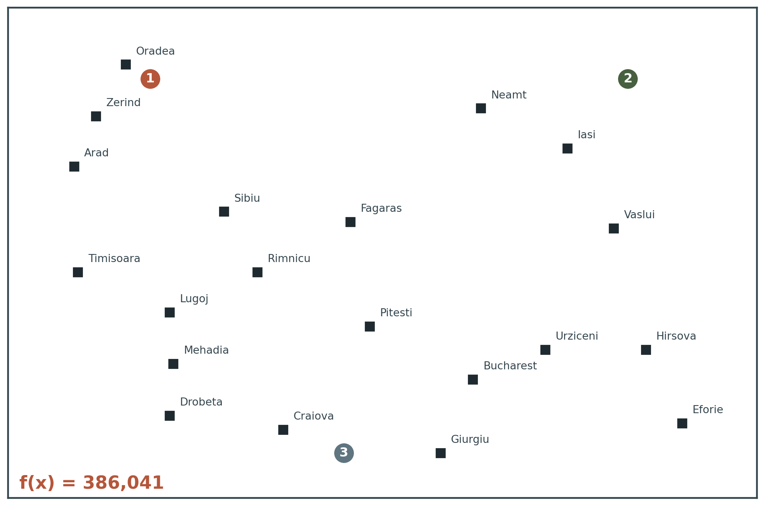
4.2 RUNNING EXAMPLE
Siting three airports in Romania
The task
Place three new airports anywhere in Romania, such that the sum of squared straight-line distances from each city on the map to its nearest airport is minimised.
The state space
The coordinates of the three airports:
(x₁,y₁), (x₂,y₂), (x₃,y₃).
A six-dimensional space. In general, states are defined by an n-dimensional vector of variables x.
Moving in this space means moving one or more airports on the map.
COMP 469 · Introduction to Artificial Intelligence · CSU Channel Islands
64
Notes:
Note the reuse of the Romania map from Chapter 3 — and that we are now using it for something completely different. In Chapter 3 the edges mattered and we searched for a path. Here the edges are irrelevant; only the city coordinates matter, and we are searching for a configuration. That contrast is worth ten seconds because it makes the path-versus-state distinction concrete on a map they already know.

Slide 65
4.2 FORMALISING
The objective function
Let Cᵢ be the set of cities whose closest airport, in the state x, is airport i. Then:
f(x) = f(x₁, y₁, x₂, y₂, x₃, y₃) = Σᵢ₌₁³ Σ c∈Cᵢ ( (xᵢ − x_c)² + (yᵢ − y_c)² )
Equation 4.1
Cheap to evaluate
Squared, not plain, distance
Once you know which cities are closest to which airport, f is a sum of squared distances — a few dozen arithmetic operations.
Squaring makes f differentiable everywhere and penalises one badly-served city more than several mildly-served ones. That is a modelling choice.
The catch that defines the rest of this section: this equation is correct for x and for states in the local neighbourhood of x — but it is not correct globally. Stray far enough and the set of closest cities for an airport changes, so Cᵢ must be recomputed and the formula is a different formula.
COMP 469 · Introduction to Artificial Intelligence · CSU Channel Islands
65
Notes:
The locally-but-not-globally-correct point is subtle and important. The objective is piecewise smooth: within a region where the assignment of cities to airports is fixed, f is a clean quadratic. Cross a boundary and you are on a different quadratic. Students who have seen k-means will recognise this immediately — it is the same structure, and the algorithm we derive in a few slides is essentially Lloyd's algorithm.

Slide 66
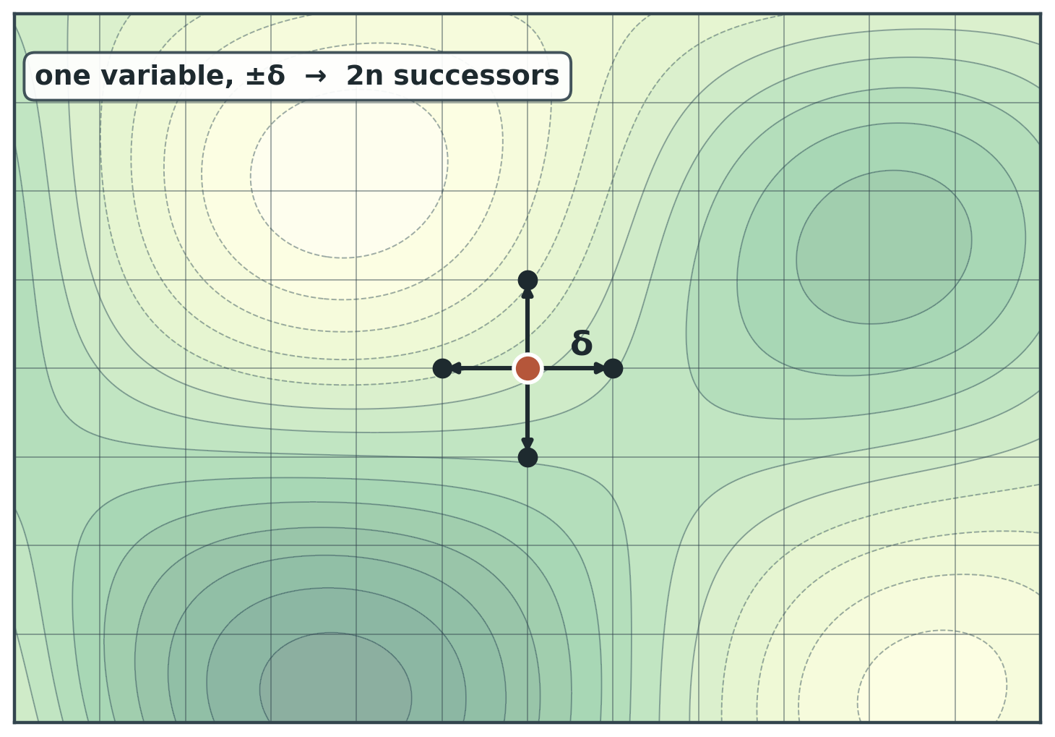
4.2 APPROACH 1 OF 4
Discretize the space
Instead of allowing (xᵢ, yᵢ) to be any point in continuous space, limit them to fixed points on a rectangular grid with spacing δ.
Each state now has 12 successors: increment or decrement one of the 6 variables by δ.
In general, 2n successors for n variables.
Now apply any of the discrete algorithms unchanged — hill climbing, annealing, beam search.
The trade-off is δ. Large δ moves fast and cannot express a fine answer; small δ is precise and crawls.
COMP 469 · Introduction to Artificial Intelligence · CSU Channel Islands
66
Notes:
The 12 comes from 6 variables times 2 directions — make students derive it, it is the fastest check that they understood the state representation. Discretization is the approach students reach for by default, and it deserves respect: it is often the right answer for low-dimensional problems with no usable derivative. It stops being the right answer as n grows, because 2n successors per step in a fine grid is a very slow way to travel.

Slide 67
4.2 APPROACH 2 OF 4
Sample successors, measure empirically
Alternatively, make the branching factor finite by sampling successor states at random: move in a random direction by a small amount δ.
Methods that measure progress by the change in the value of the objective function between two nearby points are called empirical gradient methods.
What it really is
Shrinking δ over time
Empirical gradient search is the same as steepest-ascent hill climbing in a discretized version of the state space. You are estimating the slope by finite differences instead of computing it.
Reducing δ as the search proceeds gives a more accurate solution — but it does not necessarily converge to a global optimum in the limit. Precision is not the same as correctness.
Use this when f is available only as a black box — a simulation, a physical measurement, a piece of code you cannot differentiate. You pay for the derivative in function evaluations rather than in calculus.
COMP 469 · Introduction to Artificial Intelligence · CSU Channel Islands
67
Notes:
The black-box framing is what makes this approach memorable and is how it is used in practice — hyperparameter tuning, simulation optimization, and A/B-style experiments all live here. Cost warning worth stating: a finite-difference gradient in n dimensions costs at least n+1 function evaluations per step. In high dimensions that is brutal, which is exactly why automatic differentiation matters in machine learning.

Slide 68
4.2 APPROACH 3 OF 4
Use the gradient analytically
Often we have an objective function in a mathematical form such that we can use calculus to solve the problem analytically rather than empirically.
∇f = ( ∂f/∂x₁ , ∂f/∂y₁ , ∂f/∂x₂ , ∂f/∂y₂ , ∂f/∂x₃ , ∂f/∂y₃ )
The gradient of the objective function is a vector ∇f that gives the magnitude and direction of the steepest slope.
In some cases: solve ∇f = 0
In many cases: you cannot
Placing a single airport, the solution is the arithmetic mean of all the cities' coordinates. Closed form, no iteration, done.
With three airports the expression for the gradient depends on which cities are closest to which airport in the current state. No closed form exists.
So we compute the gradient locally rather than globally — and then iterate. That single compromise is the origin of every iterative optimizer you will ever use.
COMP 469 · Introduction to Artificial Intelligence · CSU Channel Islands
68
Notes:
The one-airport case is worth doing on the board: differentiate the sum of squared distances, set to zero, and the centroid falls out in three lines. Students find it satisfying and it makes the three-airport difficulty concrete by contrast. Why three airports is hard: C-sub-i depends on x, so f is not one smooth function but a patchwork, and the patch boundaries move as you move.

Slide 69
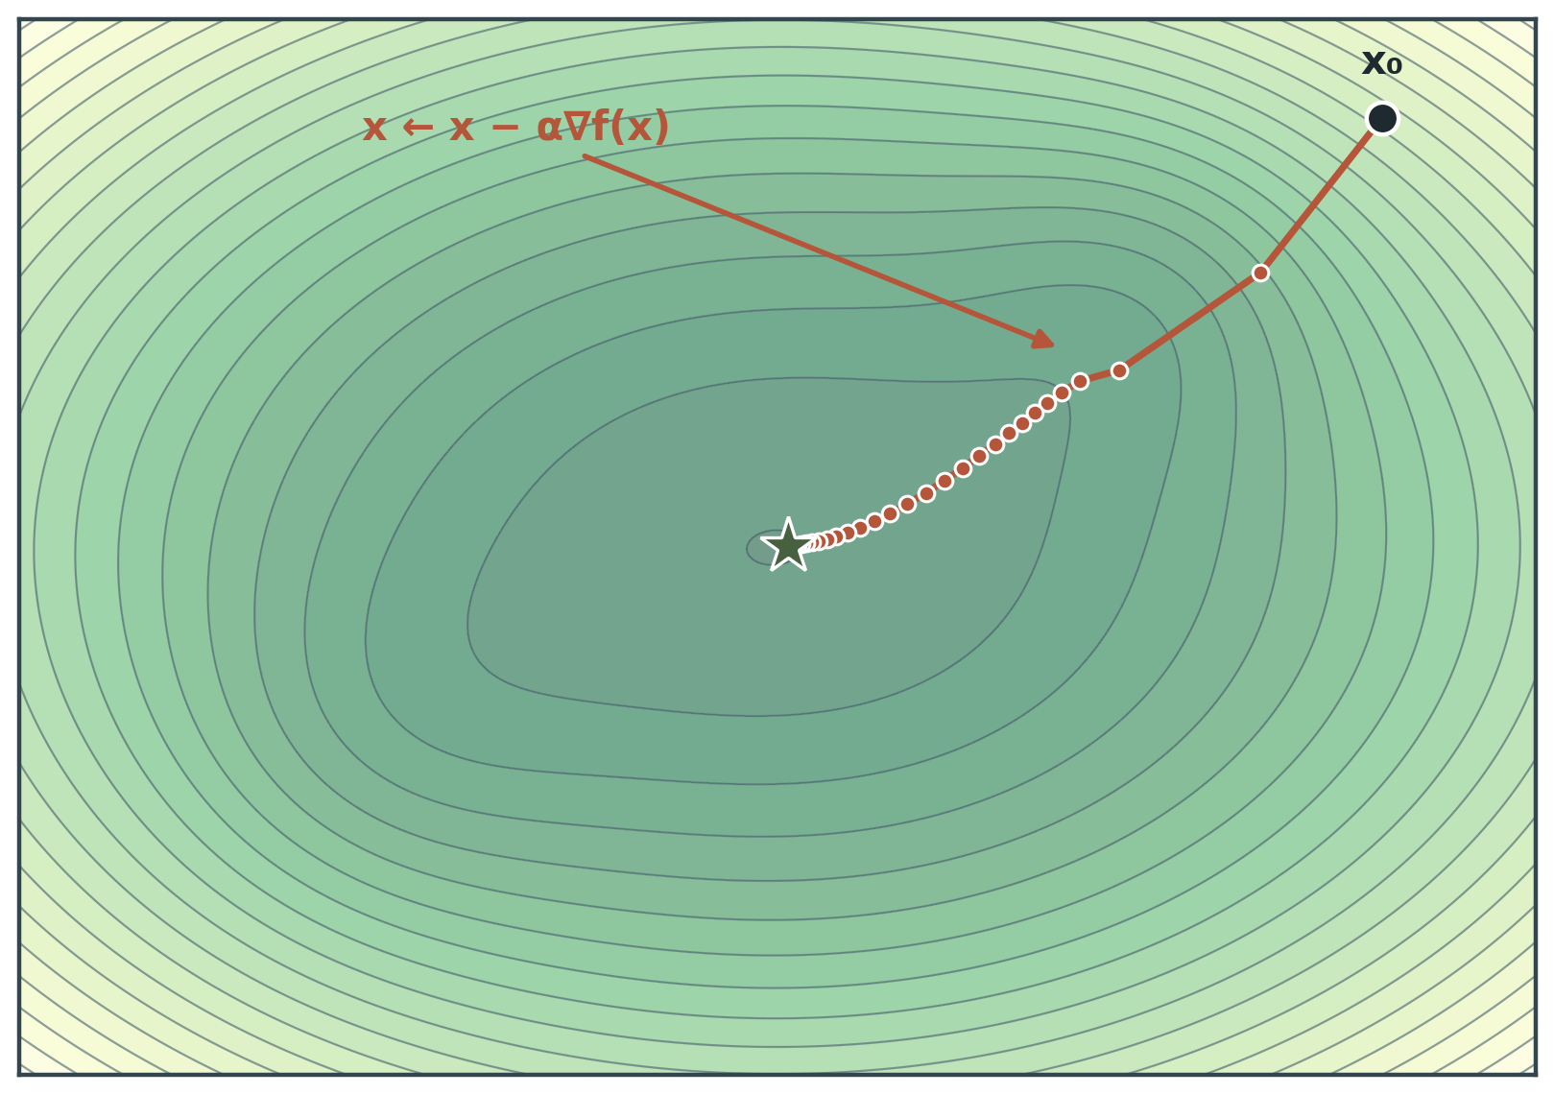
4.2 THE UPDATE RULE
Steepest ascent in a continuous space
The locally correct expression for one component of the gradient:
∂f/∂x₁ = 2 Σ c∈C₁ (x₁ − x_c)
x ← x + α ∇f(x)
Equation 4.2
steepest ascent ( use − for descent )
α is a small constant, called the step size. In machine learning it is called the learning rate — same quantity, different vocabulary.
Note what the algorithm has become: pick a direction using local information, take a step, repeat until nothing improves. That is hill climbing, in a space where “the best neighbour” is now computed rather than searched for.
There exists a huge variety of methods for adjusting α, and choosing it badly is the most common way to make a working optimizer fail.
COMP 469 · Introduction to Artificial Intelligence · CSU Channel Islands
69
Notes:
Say the words 'learning rate' out loud. Half the room has met alpha under that name and will not otherwise connect the two. The middle bullet is the payoff of the whole lecture: we have travelled from a 56-successor enumeration on a chessboard to the update rule at the heart of neural network training, and it is recognisably the same algorithm.

Slide 70
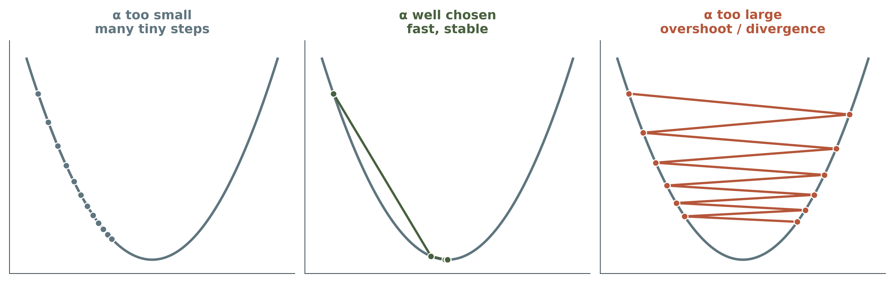
4.2 TUNING
The step size problem, and line search
The basic problem
Line search
If α is too small, too many steps are needed. If α is too large, the search could overshoot the maximum.
Extend the current gradient direction — usually by repeatedly doubling α — until f starts to decrease again. That point becomes the new current state.
COMP 469 · Introduction to Artificial Intelligence · CSU Channel Islands
70
Notes:
The third panel is the one to point at: divergence is not a slow failure, it is an immediate and spectacular one. Students who have watched a training loss go to NaN have seen exactly this. Line search converts a hyperparameter into a computation, at the cost of extra function evaluations per step. There are several schools of thought about how the new direction should be chosen after a line search terminates — that is the whole field of nonlinear optimization and is well beyond us here.

Slide 71
4.2 APPROACH 4 OF 4
Newton–Raphson: use the curvature too
For many problems, the most effective algorithm is the venerable Newton–Raphson method — a general technique for finding roots of functions, that is, solving g(x) = 0.
Scalar root finding
Applied to optimization: find where ∇f(x) = 0
x ← x − g(x) / g′(x)
x ← x − Hᶠ⁻¹(x) ∇f(x)
To find a maximum or minimum of f we need x such that the gradient is the zero vector, so g(x) in Newton’s formula becomes ∇f(x), and g′ becomes the Hessian matrix Hᶠ of second derivatives, with entries Hᵢⱼ = ∂²f / ∂xᵢ∂xⱼ.
Why bother
Why not always
The gradient tells you which way is downhill. The Hessian tells you how the slope is changing — so Newton can compute how far to step instead of guessing. No α to tune.
For high-dimensional problems, computing the n² entries of the Hessian and inverting it may be expensive. Many approximate versions of Newton–Raphson have been developed for exactly this reason.
COMP 469 · Introduction to Artificial Intelligence · CSU Channel Islands
71
Notes:
Do not derive anything here. The takeaway is conceptual: gradient descent uses first-order information, Newton uses second-order information, and second-order information buys you the step size for free at a cost of n-squared. If someone asks what the approximate versions are called: quasi-Newton methods, BFGS and L-BFGS being the famous ones. L-BFGS is what you will meet in practice.

Slide 72
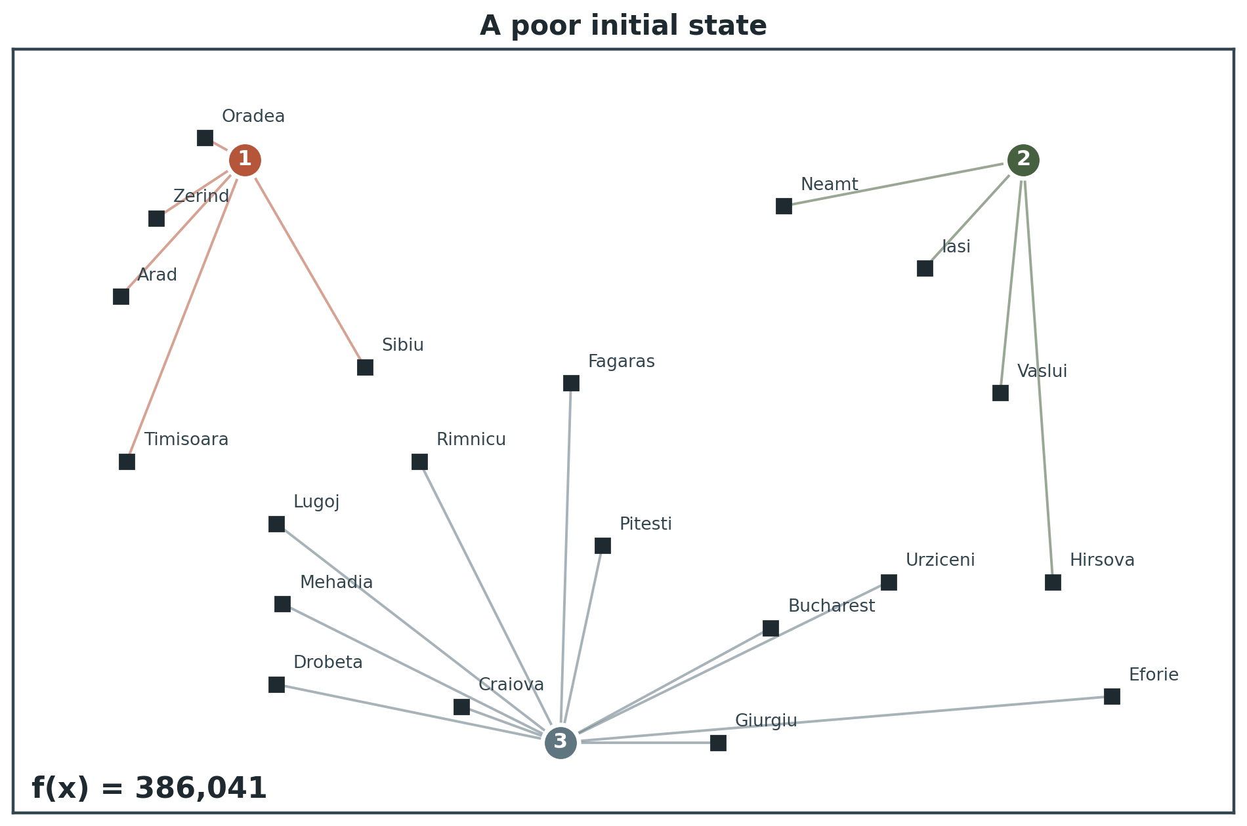
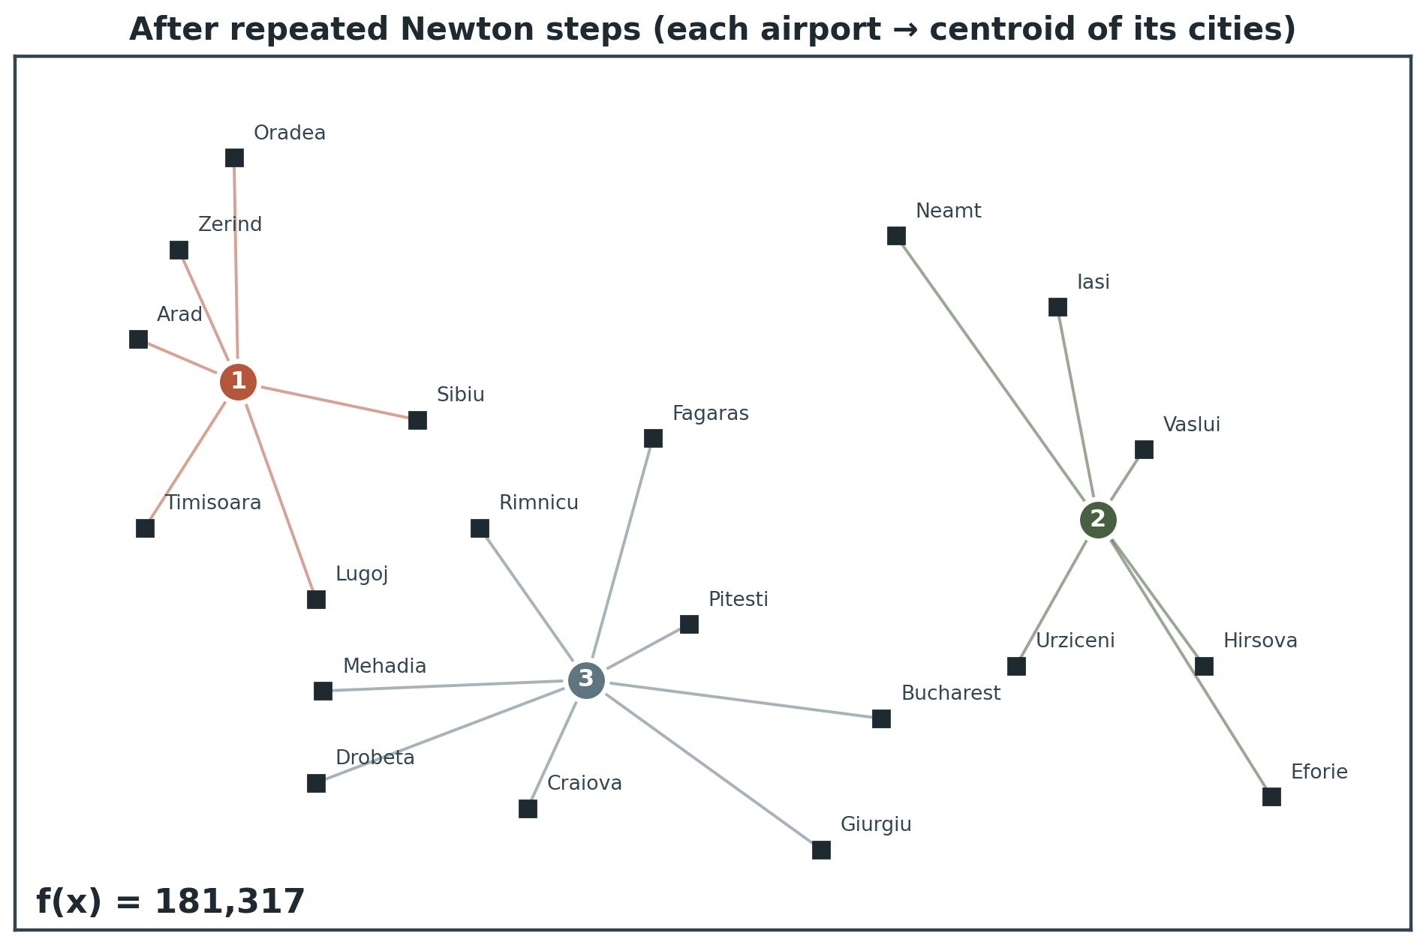
4.2 WORKED EXAMPLE
Newton on the airport problem: one step is a centroid
→
From Equation 4.2 the Hessian is particularly simple: the off-diagonal elements are zero, and the diagonal elements for airport i are just twice the number of cities in Cᵢ.
A moment’s calculation shows that one step of the Newton update moves airport i directly to the centroid of Cᵢ — the minimum of the local expression for f.
So: assign each city to its nearest airport, move each airport to the centre of its cities, repeat. If that sounds like k-means clustering, it is — k-means is Newton–Raphson on this objective.
COMP 469 · Introduction to Artificial Intelligence · CSU Channel Islands
72
Notes:
The k-means connection is not in the textbook and it is the single most valuable thing you can add to this section. Students who have taken a data course get an immediate 'oh, THAT is what k-means is' moment, and students who have not now have a hook for when they meet it. The objective values are printed on both maps — the drop from the left panel to the right is the optimization actually happening.

Slide 73
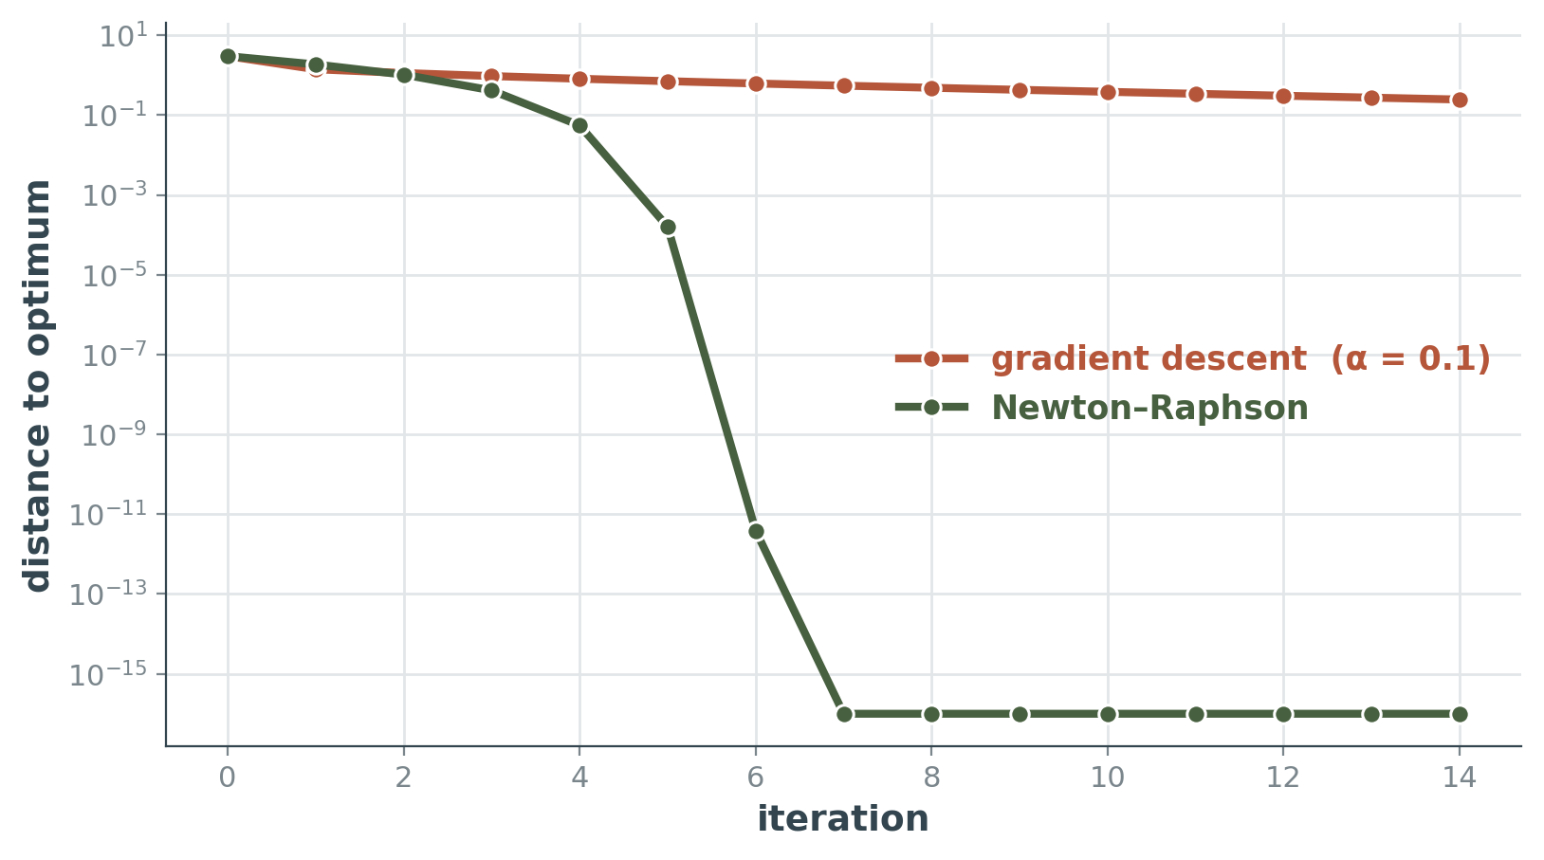
4.2 COMPARISON
First-order and second-order convergence
Note the logarithmic vertical axis. Gradient descent takes a roughly constant proportion off the error each step; Newton roughly squares the error each step near the optimum.
Per iteration, though, Newton is far more expensive: n² second derivatives and a matrix inversion, against n first derivatives.
Which wins depends entirely on n. This is exactly why deep learning uses first-order methods: with millions of parameters, the Hessian is not merely expensive, it does not fit in memory.
The general lesson
More information per step means fewer steps and more cost per step. Discretization, empirical gradients, analytic gradients, and Newton–Raphson form a ladder of exactly that trade — the same trade you met with A* heuristics, where a better estimate expanded fewer nodes but cost more per node.
COMP 469 · Introduction to Artificial Intelligence · CSU Channel Islands
73
Notes:
The callback to A* heuristic quality versus per-node cost is worth making explicitly. It is the same economic structure appearing in a completely different setting, and students who see the pattern once tend to start looking for it.

Slide 74
4.2 REALITY CHECK
Continuous does not mean easy
Local search methods suffer from local maxima, ridges, and plateaus in continuous state spaces just as much as in discrete spaces.
The same three failures
The same two remedies
One new difficulty
A gradient of zero means a local optimum, a saddle point, or a plateau. The derivative cannot tell you which, and none of them is necessarily the answer you wanted.
Random restarts and simulated annealing are often helpful — the discrete toolkit transfers directly, and in practice people use it.
High-dimensional continuous spaces are big places in which it is very easy to get lost. Intuition built in two dimensions is actively misleading in a thousand.
Why intuition fails in high dimensions
In two dimensions, a point where the gradient vanishes is usually a genuine peak or valley. In n dimensions it is far more likely to be a saddle — sloping down along some axes and up along others — because all n curvatures would have to agree in sign for a true optimum. This is the modern explanation for why gradient descent works better on huge models than the two-dimensional picture suggests.
COMP 469 · Introduction to Artificial Intelligence · CSU Channel Islands
74
Notes:
The saddle-point observation is not in the textbook but it is the standard modern account and it directly answers the question a sharp student will ask: if the landscape is full of local minima, why does deep learning work at all? Answer: in very high dimensions, most critical points are saddles, and gradient methods with noise escape saddles. Keep it to two sentences unless someone asks.

Slide 75
4.2 FINAL TOPIC
Constrained optimization
An optimization problem is constrained if solutions must satisfy hard constraints on the values of the variables.
In the airport problem: sites must be inside Romania, and on dry land rather than in the middle of lakes. Neither constraint is expressible as a penalty in f without changing what “optimal” means.
The difficulty depends entirely on the nature of the constraints and of the objective function.
Linear programming
Convex optimization
Constraints must be linear inequalities forming a convex set, and the objective function must also be linear.
The time complexity is polynomial in the number of variables. Probably the most widely studied and broadly useful method for optimization.
The general case of which linear programming is a special case: the constraint region may be any convex region and the objective any function convex within it.
Also polynomially solvable under certain conditions, and feasible in practice with thousands of variables.
Several important problems in machine learning and control theory can be formulated as convex optimization problems — we return to this in Chapter 20. When your problem is convex, do not use local search: use a convex solver and get a certificate of optimality.
COMP 469 · Introduction to Artificial Intelligence · CSU Channel Islands
75
Notes:
The closing sentence is the practical rule and it deserves emphasis: convexity means there is exactly one local optimum and it is global, so every difficulty from the last two hours evaporates. Recognising convexity is worth real money. Do not attempt to define convexity rigorously here. 'The line segment between any two points in the region stays inside the region, and the chord between any two points on the function stays above it' is enough for now.

Slide 76
WRAP-UP
Choosing an algorithm
Your problem is convex, or your constraints are linear
→
Use a convex solver or a linear program. Not local search.
Discrete, moderate branching factor, you can afford to fail and retry
→
Random-restart hill climbing with sideways moves. Simple, and a mandatory baseline.
Discrete, rugged landscape, tuning time available
→
Simulated annealing. Budget as much effort for the cooling schedule as for the code.
Enormous branching factor, or successors are expensive to enumerate
→
First-choice hill climbing, or annealing. Never steepest ascent.
Solutions decompose into meaningful, recombinable components
→
A genetic algorithm — but engineer the representation first, and benchmark against restarts.
Continuous, and you can differentiate f
→
Gradient descent with line search or a tuned step size; Newton or quasi-Newton if n is small.
Note that the first row sends you out of this chapter entirely. Recognising when local search is the wrong tool is as valuable as knowing how to run it.
Continuous, f is a black box
→
Empirical gradient methods, or discretize and use a discrete algorithm.
COMP 469 · Introduction to Artificial Intelligence · CSU Channel Islands
76
Notes:
Photograph-worthy summary slide; tell them so. It also doubles as a project-planning aid. If you want a discussion prompt to close on: ask which row their own semester project falls into. Most will discover they have not characterised their objective function well enough to answer, which is itself the lesson.

Slide 77
WRAP-UP
Six things that cost points on the exam
“Hill climbing found a solution”
“Random restarts make it complete”
It found a state no neighbour improves. That is all termination means.
Complete with probability 1, which is a different and weaker claim. Say the qualifier.
“The 8-queens branching factor is 8”
“Simulated annealing accepts bad moves with probability T”
It is 56: eight columns times seven alternative squares in each.
With probability e^(ΔE/T). Both ΔE and T matter, and the dependence is exponential.
“Local beam search is k hill climbers in parallel”
“Genetic algorithms beat hill climbing”
The shared successor pool means lineages compete for slots. That competition is the algorithm.
Only when the representation makes crossover meaningful. Otherwise they are slower stochastic beam search.
Each of these is a real answer from a real exam. The pattern is the same every time: a correct-sounding sentence with the precision removed.
COMP 469 · Introduction to Artificial Intelligence · CSU Channel Islands
77
Notes:
Two minutes, delivered briskly. Students take this slide seriously in a way they do not take a generic 'study hard' slide. The branching-factor item is the highest-frequency error by a wide margin.

Slide 78
WRAP-UP
One idea, in four costumes
Hill climbing
Simulated annealing
Evolutionary algorithms
Gradient descent
move to the best neighbour
move to a random neighbour, accept by temperature
recombine a population, keep the fit
move along −∇f by a step size α
discrete, enumerated
discrete, sampled
discrete, population
continuous, differentiated
All four keep a current state, use only local information to pick a change, apply it, and repeat until nothing improves. They differ in how the candidate change is proposed and how it is judged — nothing else. If you remember one sentence from this lecture, make it that one.
COMP 469 · Introduction to Artificial Intelligence · CSU Channel Islands
78
Notes:
Close the loop that you opened on slide 11. The lecture began by claiming hill climbing and gradient descent are the same algorithm; this slide is the receipt. If you have a minute spare, ask where a language model's training loop sits on this table. Answer: the last column, with the added twist that the gradient is estimated on a minibatch — which makes it stochastic gradient descent, a hybrid of the last column and the sampling idea in the second.

Slide 79
WRAP-UP
Search is only as good as its model
Every algorithm in this unit searches a model of the world, and then acts in the world itself.
The turn that did not exist
The detour through England
Where the fault lies
A routing service returned a clean, complete, cost-optimal path — onto a turn that was not there. Completeness held. Optimality held. The map was simply wrong.
A real routing bug once sent a short trip between two nearby points across another country, because a connection the real geography has was absent from the graph.
Neither is an algorithm failure. Extra edges make illegal plans look legal; missing edges make good plans invisible. No proof about the search protects you from either.
The habit to leave with
Before trusting a plan validated only in simulation, ask what the model asserts that the world does not, and what the world offers that the model was never told about. In Section 4.1 this bites harder than in Chapter 3, because the objective function is a model too — and a state that maximises the wrong f is wrong with total confidence.
COMP 469 · Introduction to Artificial Intelligence · CSU Channel Islands
79
Notes:
Three minutes, delivered slowly. This is the closing lesson of the entire search unit, not a footnote to Chapter 4. Both examples are modelling failures wearing the costume of algorithm failures. Say explicitly that nothing about completeness, optimality, admissibility or consistency was violated in either case. The local-search twist is the part worth the most: in Chapter 3 the model was the graph, and a wrong graph gave a wrong path. Here the model is the objective function, and a wrong f gives a confidently optimal answer to a question nobody asked. A security-flavoured version if you want one: an optimiser that minimises alert volume will happily achieve it by suppressing the alerts. Tie back to Lecture 2, where the same lesson appeared for problem formulation, and then move to the assignment slide.

Slide 80
BEFORE NEXT CLASS
Reading and practice
Reading
Practice problems
Russell & Norvig, Sections 4.1 and 4.2 in full, including the Evolution and Search sidebar.
Then read ahead: Sections 4.3 and 4.4 on nondeterministic actions and partial observability.
Section 4.1.5 on evolutionary algorithms in continuous spaces is optional but short.
Exercise: implement steepest-ascent hill climbing for 8-queens and reproduce the 14% success figure over 1,000 random starts.
Then add a sideways-move cap of 100 and confirm you get close to 94%.
Report both success rates and both average step counts.
Written question to bring to next class
You are scheduling 200 jobs onto 12 machines. Each schedule takes 40 ms to evaluate. You have a two-hour compute budget, which is roughly 180,000 evaluations.
Choose one algorithm from this lecture, justify the choice in one paragraph, and state what baseline you would compare it against and why. Half a page, and be specific about how you would spend the evaluation budget.
COMP 469 · Introduction to Artificial Intelligence · CSU Channel Islands
80
Notes:
The written question is deliberately underdetermined; there is no single right answer. What you are grading is whether they reason about the evaluation budget — 180,000 evaluations is enough for a great many restarts of a cheap algorithm or a handful of runs of an expensive one, and that arithmetic is the point. Strong answers will name random-restart hill climbing as the baseline, per slide 56.

Slide 81
NEXT LECTURE
Search with Nondeterministic
Actions and Partial Observability
Sections 4.3 and 4.4
4.3
When an action can have several outcomes, a solution is no longer a sequence. It is a conditional plan — a tree with branches for what you observe.
4.4
When you cannot see the whole state, the agent reasons about a belief state: the set of states it might currently be in.
81
Notes:
Close by connecting forward: today we removed the path from the problem. Next time we remove the certainty. The common thread across Chapter 4 is that every simplifying assumption we drop forces a change in what a 'solution' even is — a sequence, then a state, then a conditional plan, then a policy over belief states. Take questions here.

